Slide 1
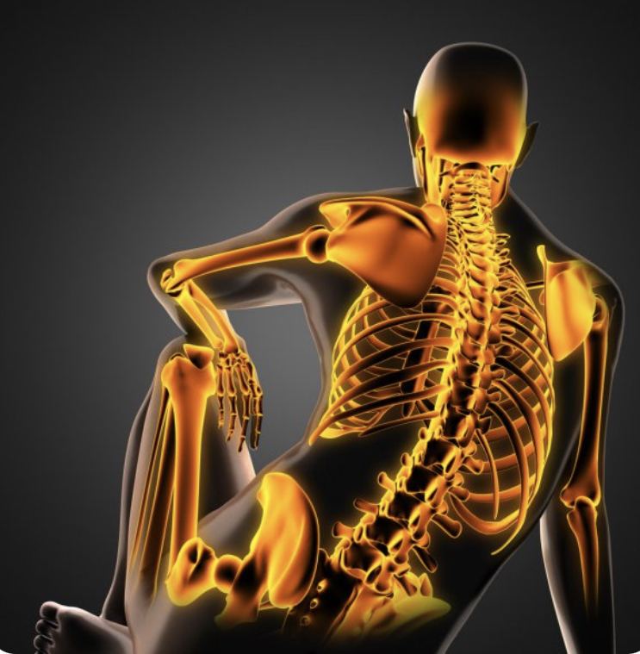
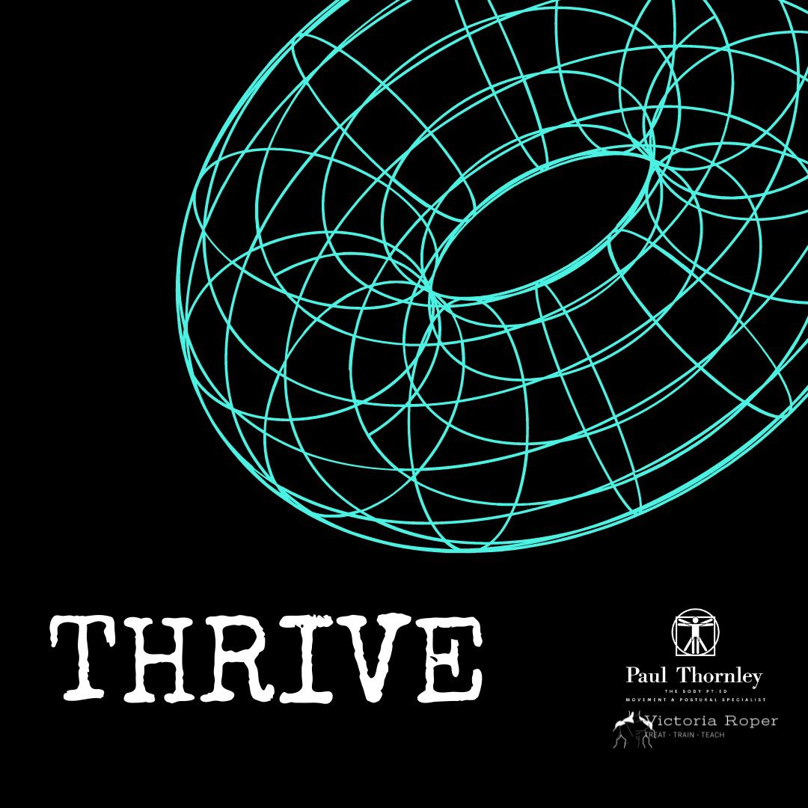
Creating Extraordinary Instructors
Joints!
21st Century Anatomy & Physiology
Living Tensegrity & Fasciategrity in Motion.

Slide 2
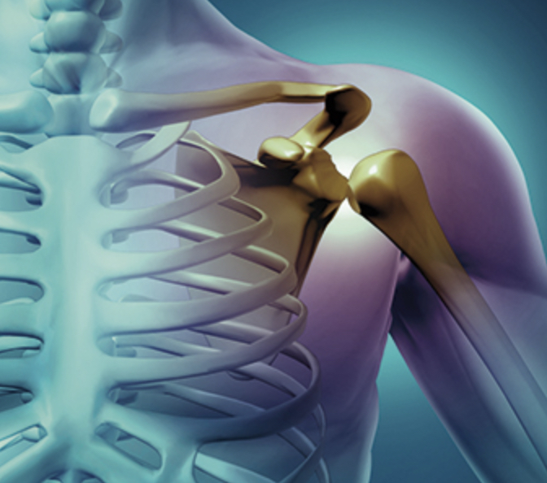
Joints are Critical to Movement ?
How did we all learn about them?
But what constitutes a joint?
Does our understanding of classical anatomy explain how to utilise & control each joint space appropriately?
What actually inhibits motion of a joint?
How can you ensure longevity of your structure?
Let’s explore a world without joints….

Slide 3
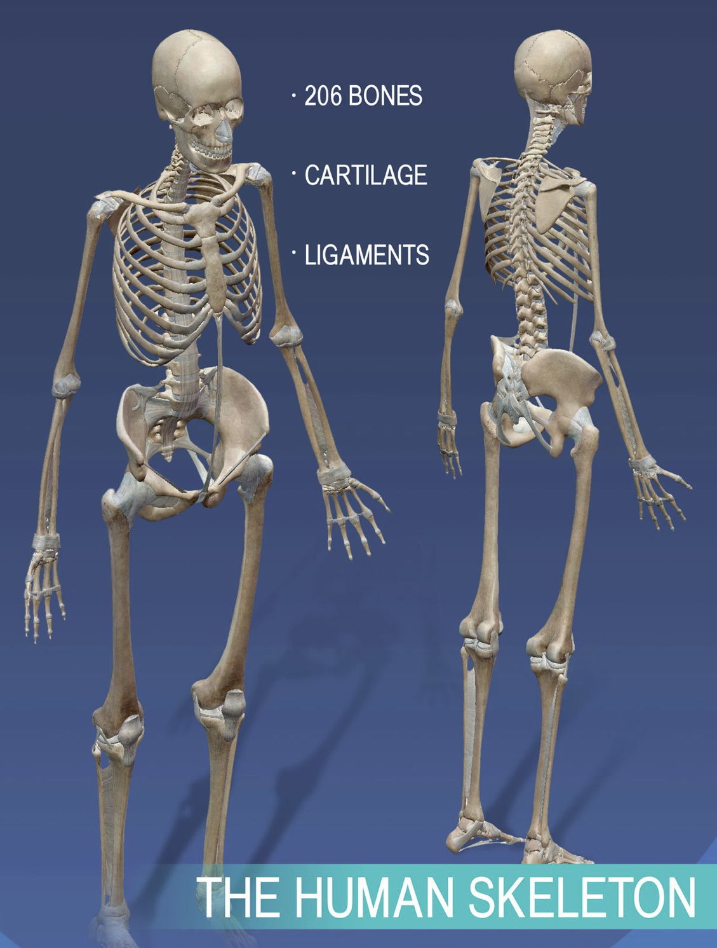
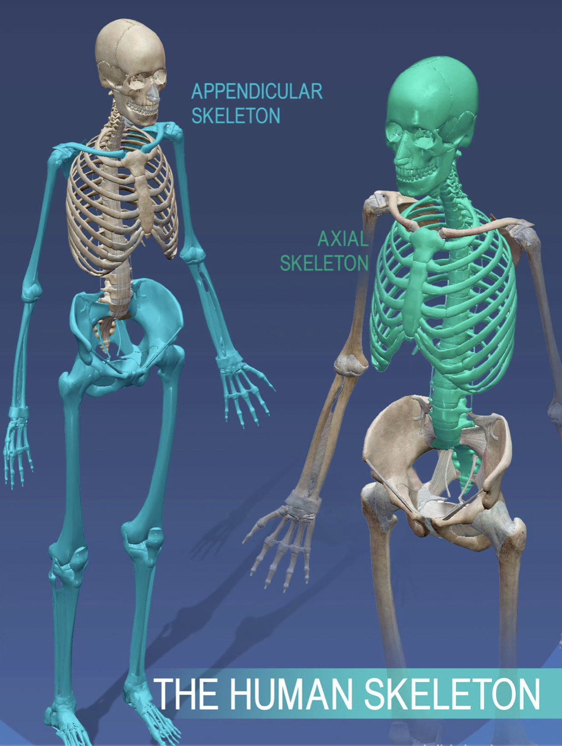
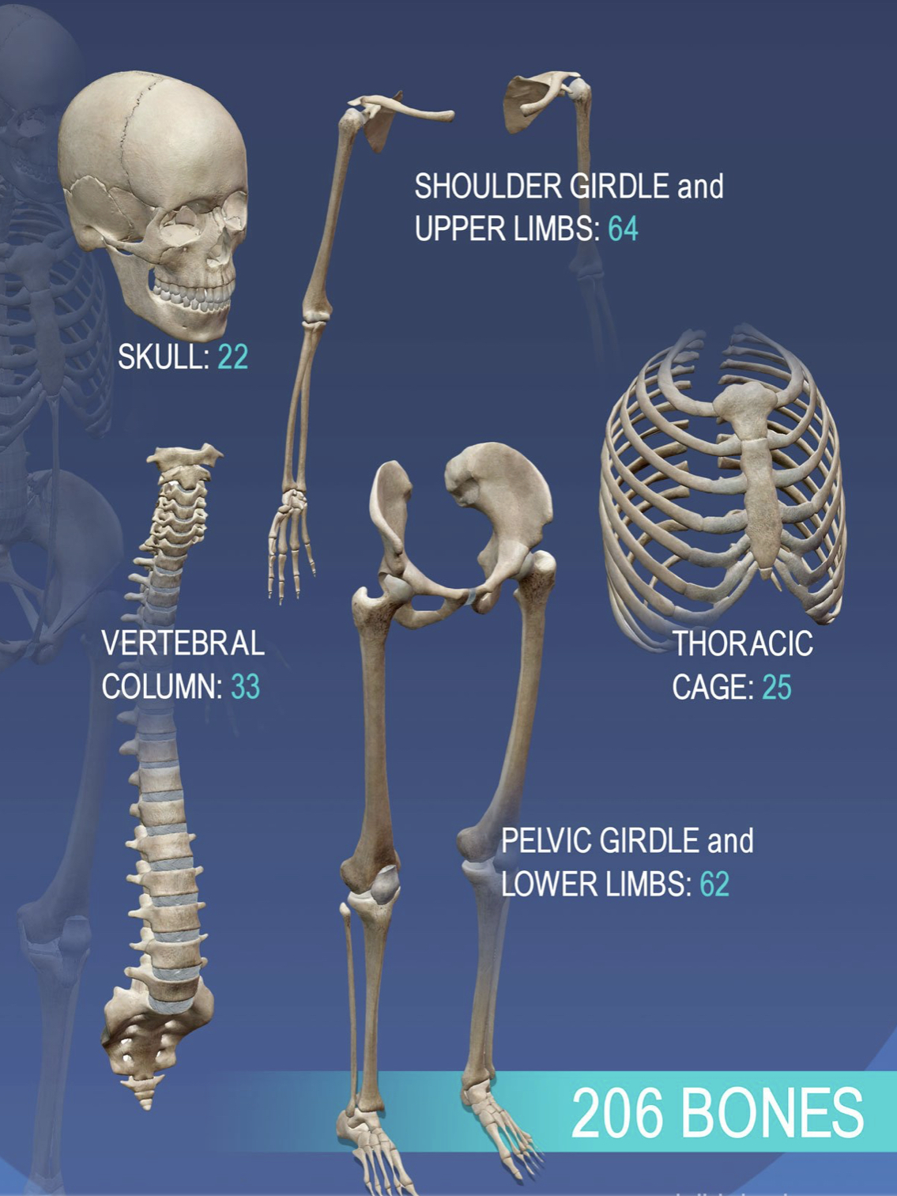
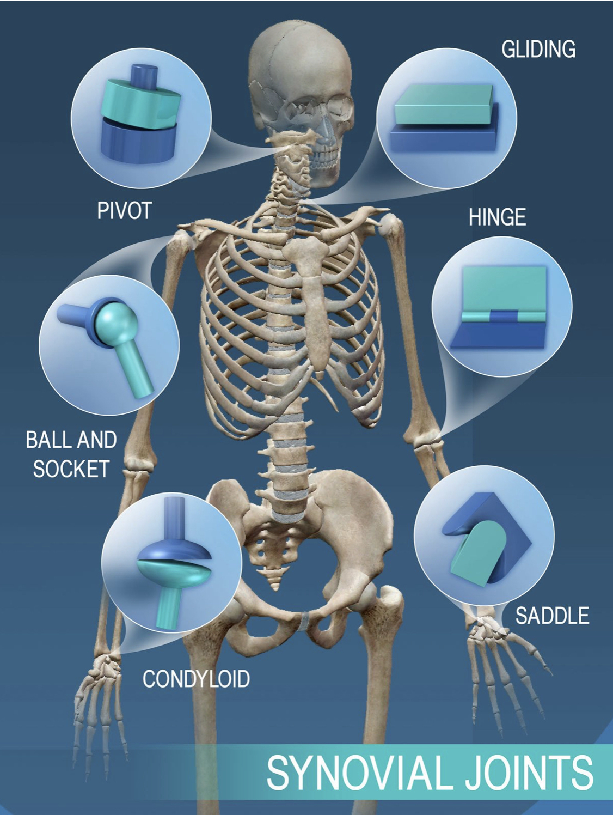
Let’s go back to school….
206 bones
Axial & Appendicular skeletal structures
Classifications of joint & bone types
Range of motion measurements
Levers of force
Co presenters of the biomechanical musculoskeletal system.

Slide 4
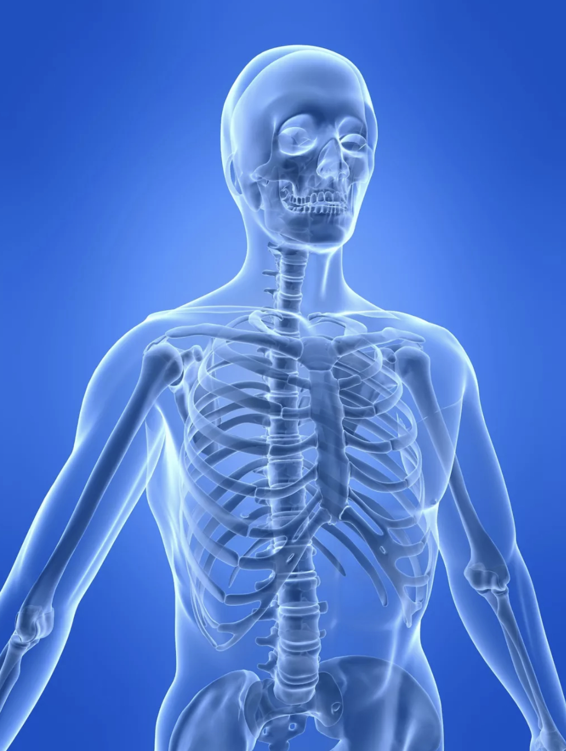
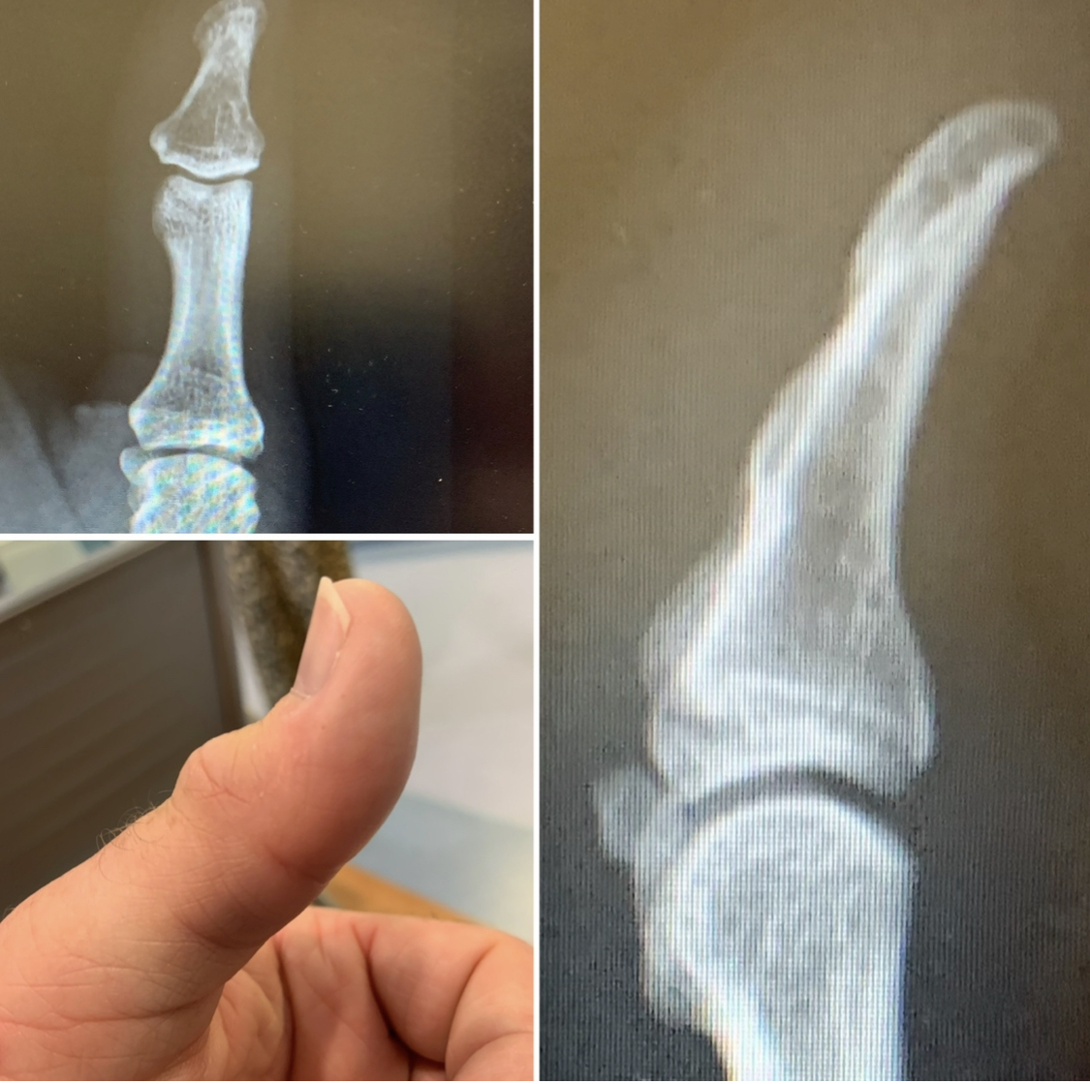
What keeps you skeletal structure upright?
There are absolutely no pins holding you together….
What’s in between them?
Just virtual space!
Imagine a world without those spaces ?
How does a Skeleton Move?

Slide 5
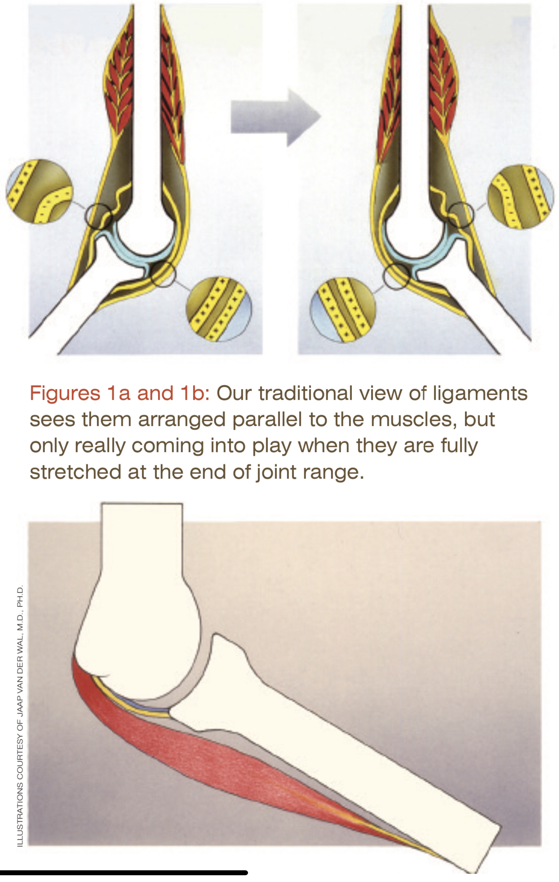
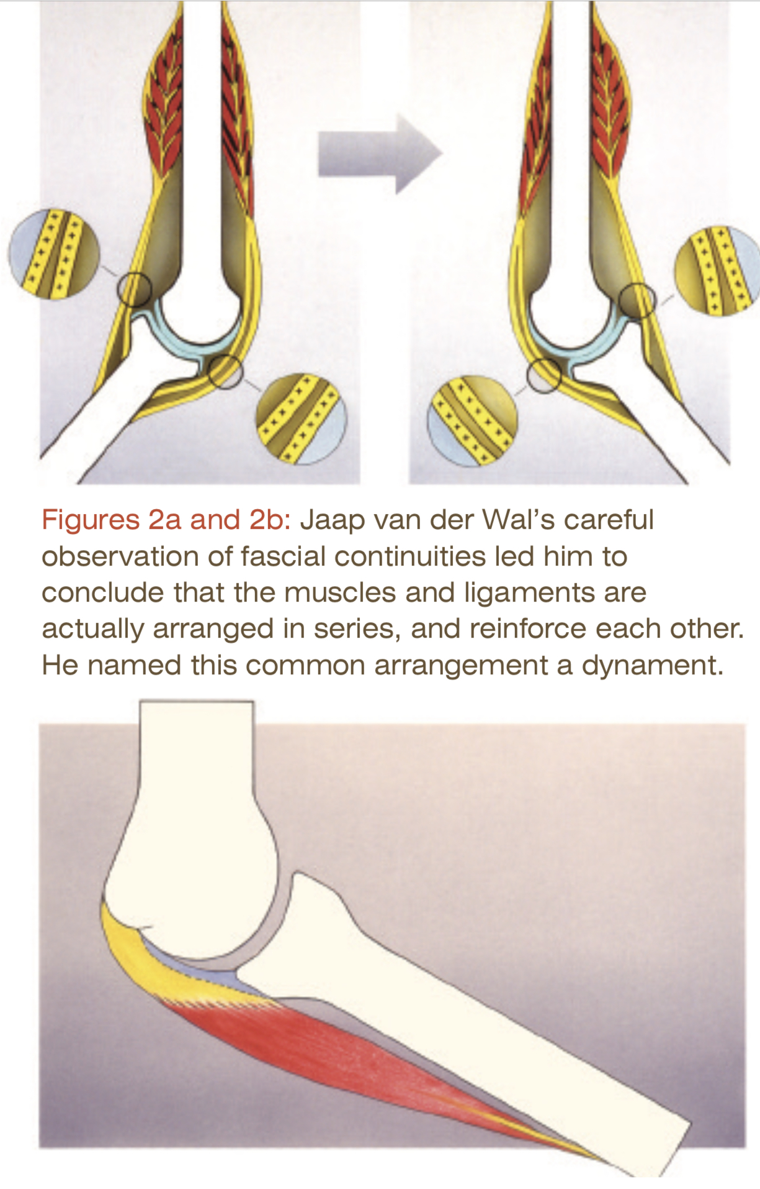
Dynamic Ligaments
Dynaments is the process of dynamic ligament tensioning.
There are very few ligaments within the body.
Ligaments run in series with the connective tissues and MyoFascia not as previously understood in parallel.
Pretensioning is fundamental in the control of forces that joint spaces must tolerate.
Neurological responses control all motion.

Slide 6
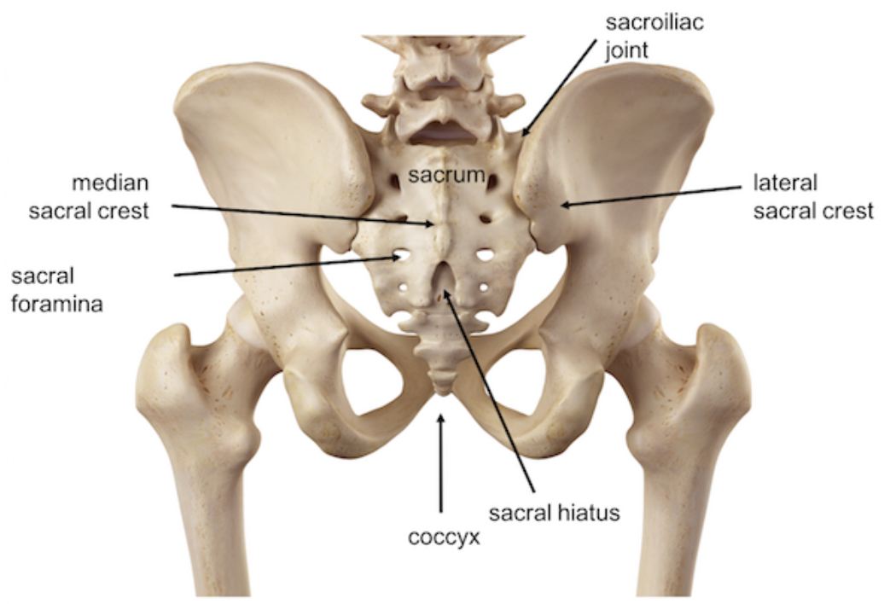
The Sacrum
Key Stone vs Suspension
Biomechanical keystone theory .
Biotensegrity suspension theory .
Understanding that we are organic adaptive tissue
Rather than mechanical , lever based structures
Perception & Reality require Interpretation.
Language & vocabulary mean everything.

Slide 7
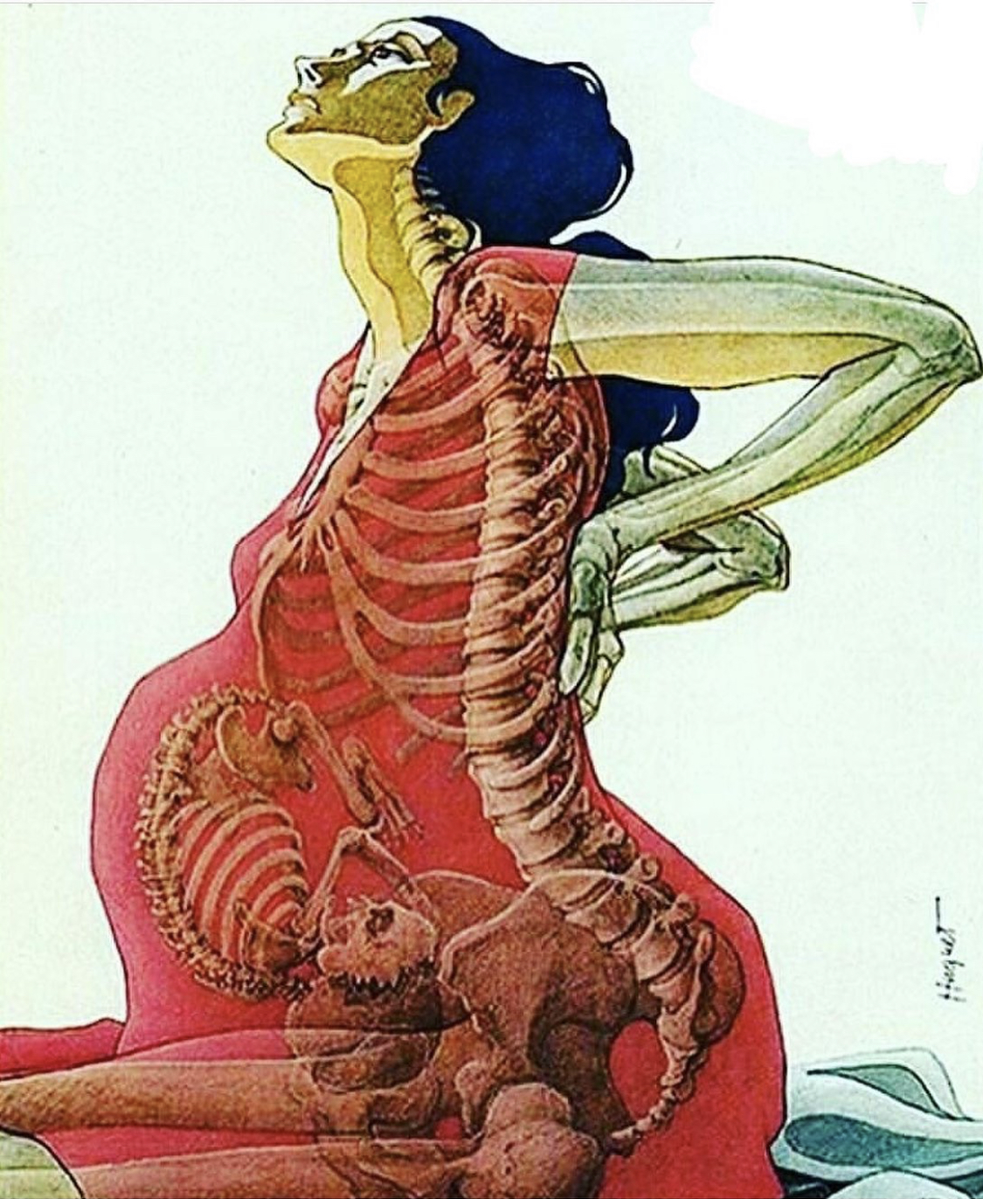
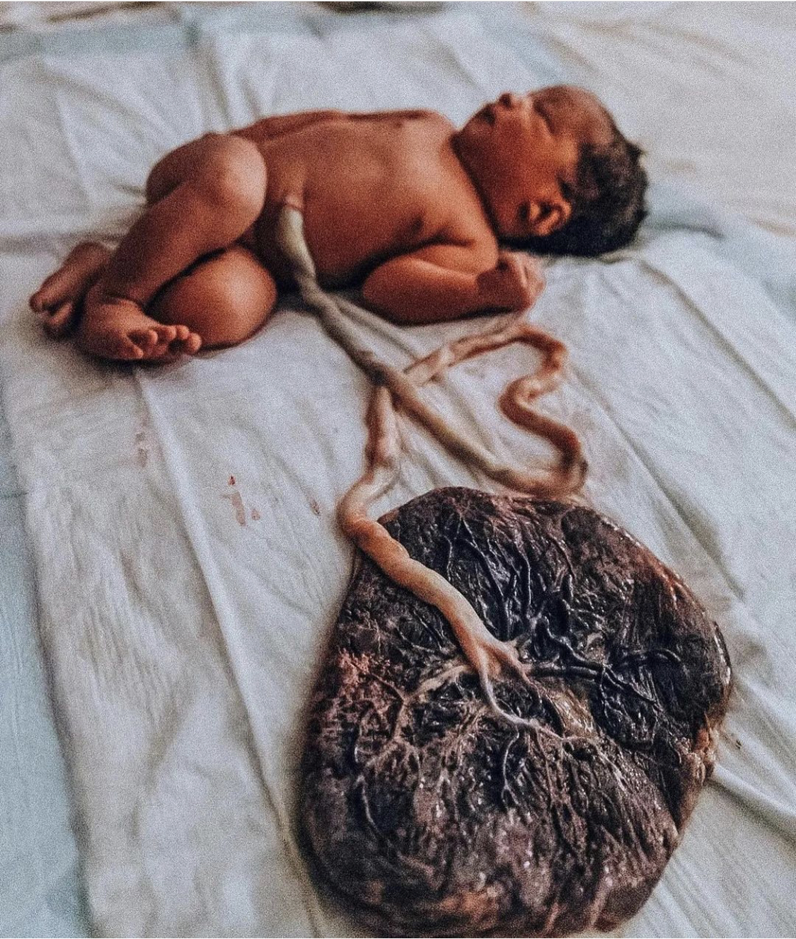
How to protect our ability to move?
Understanding that we grew ourselves.
From embryonic development to death we are adapting every moment of every day.
Have clarity how internal forces of Compression & Tension manage external influences.
Fasciategrity explains what your made of and how to influence it appropriately for Longevity.
Learn what type of contractions aid in control and how to achieve them.
Pretensioning & Hydraulic Amplification are key skills in Anticipatory Training.

Slide 8
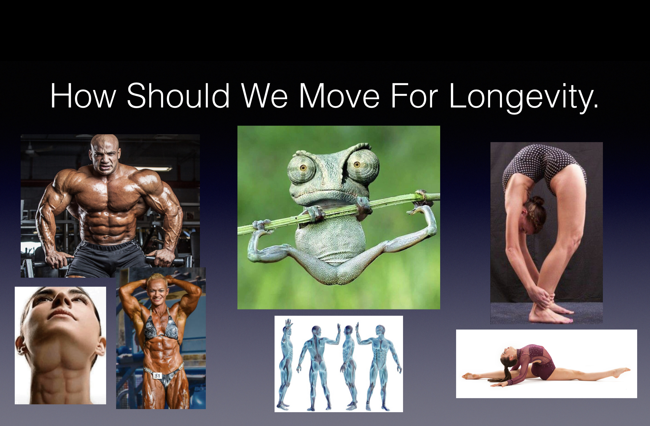

Slide 9
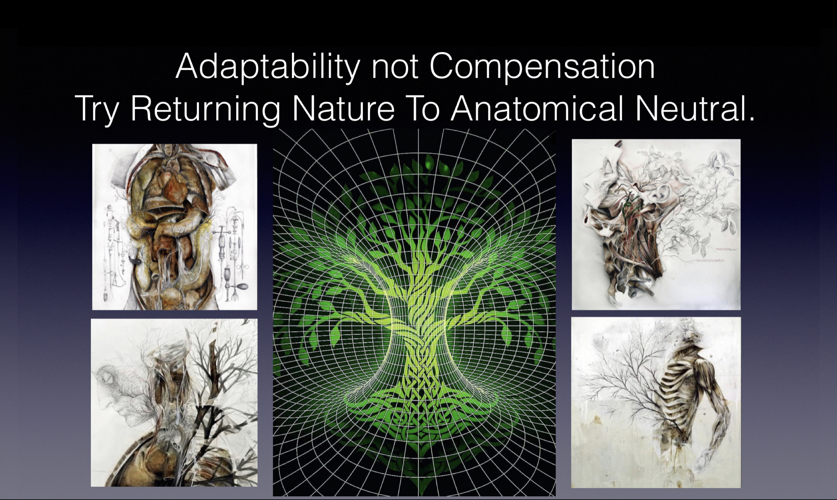

Slide 10
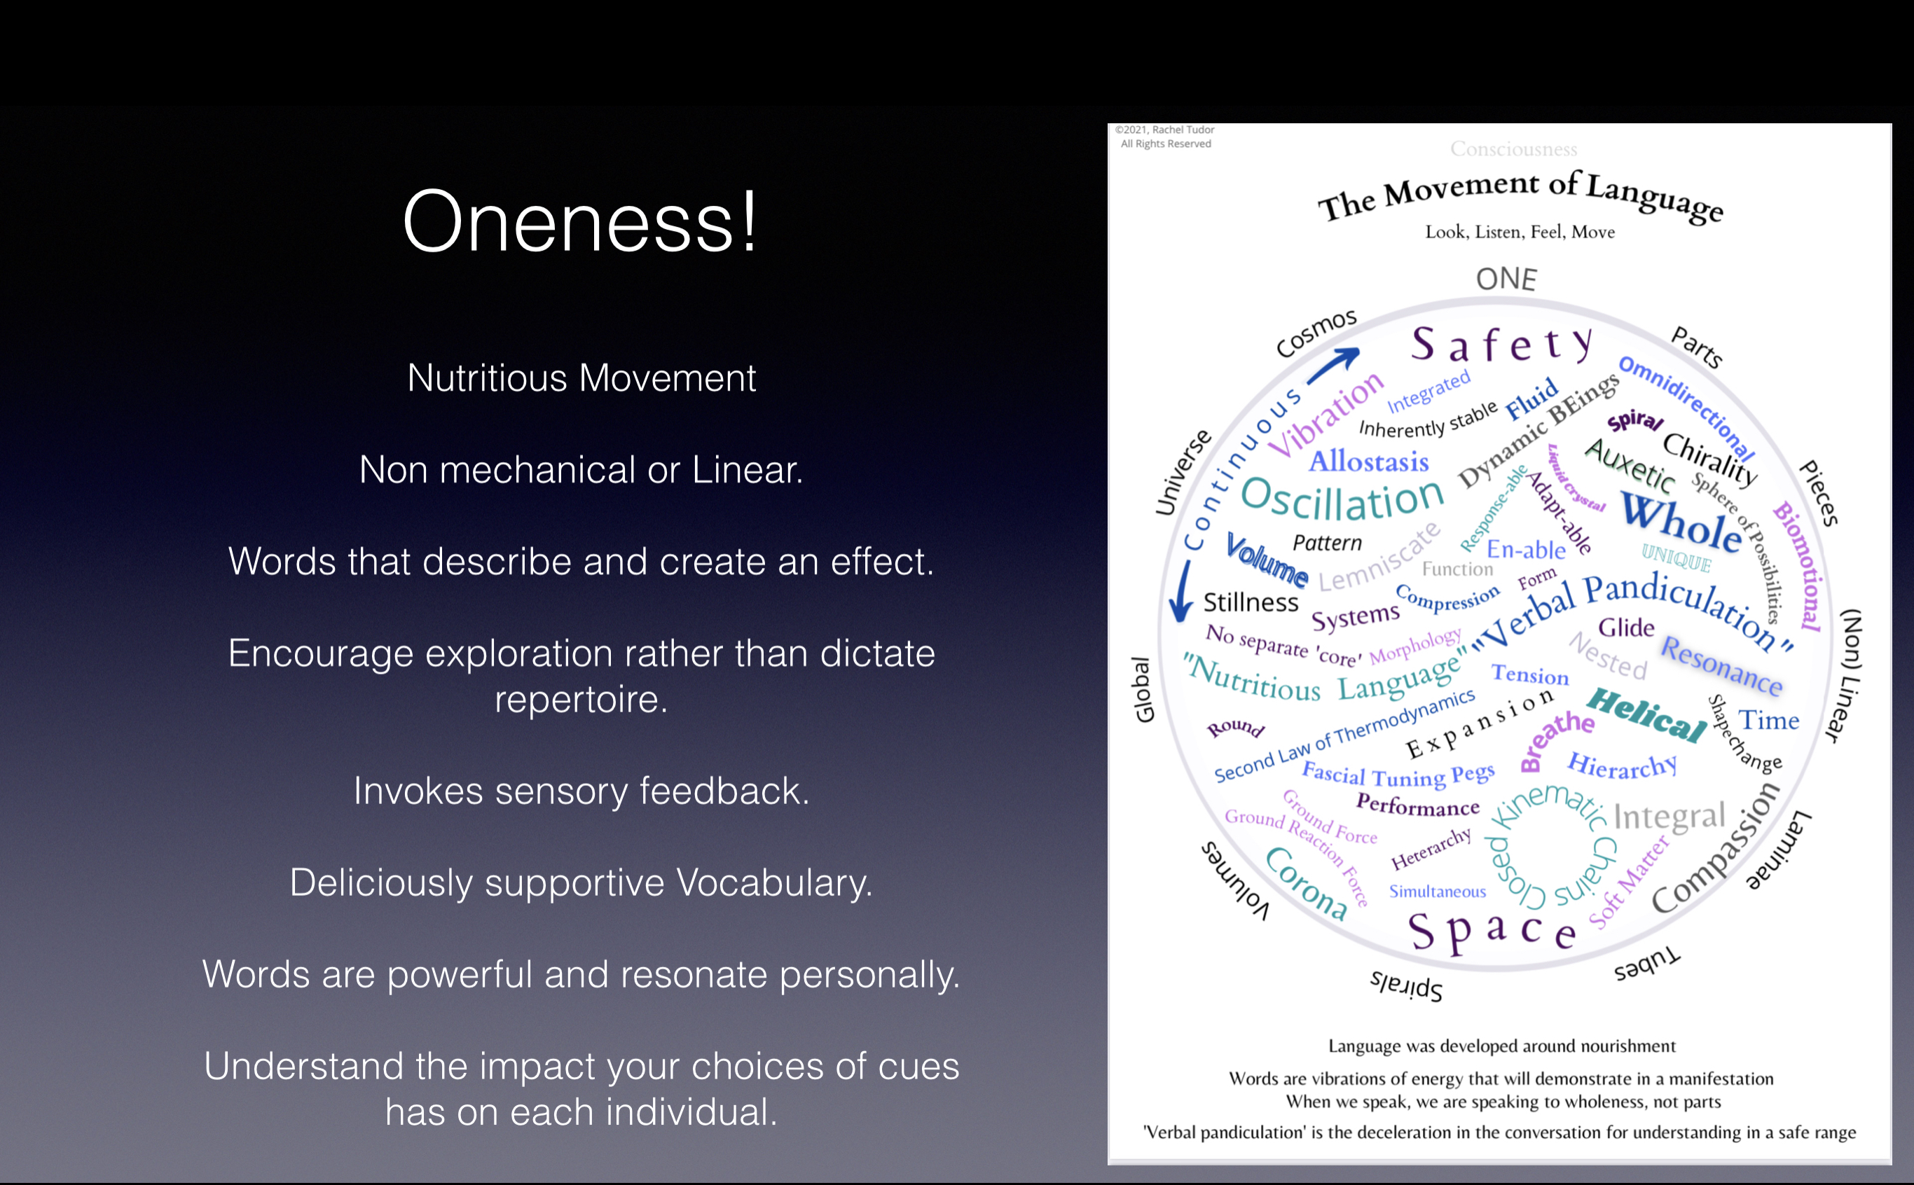

Slide 11
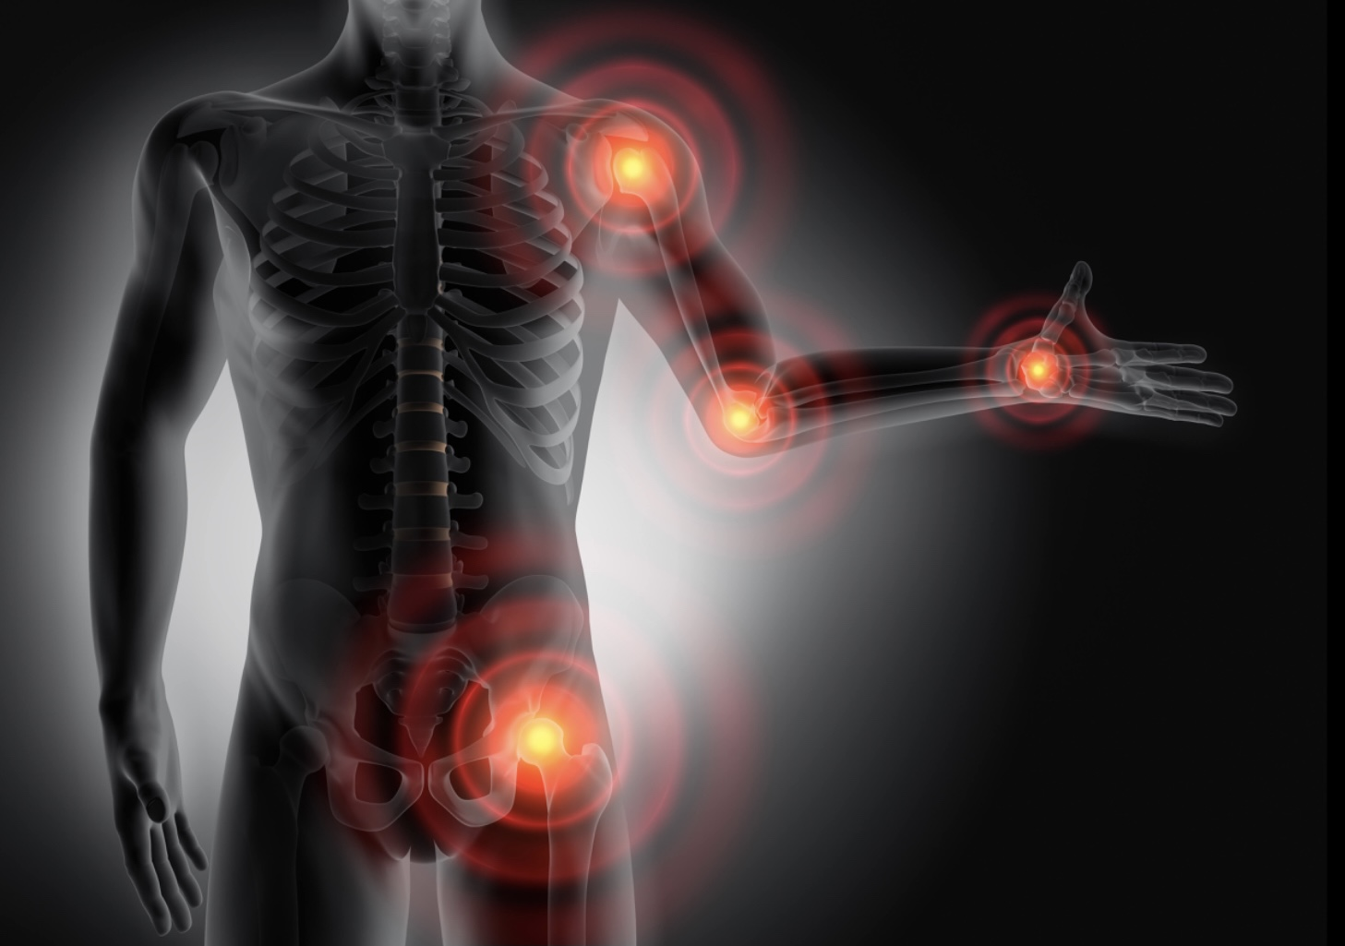
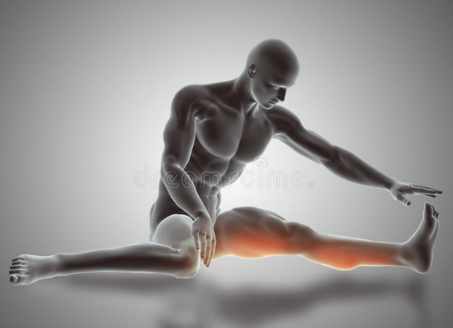
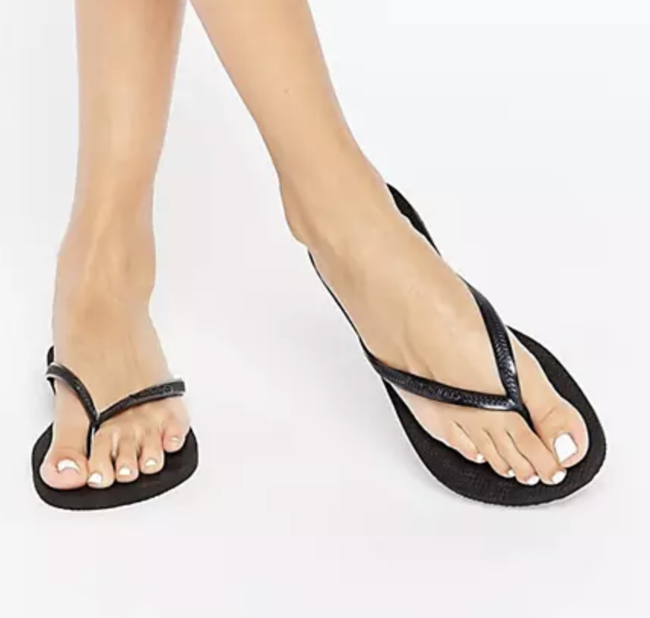

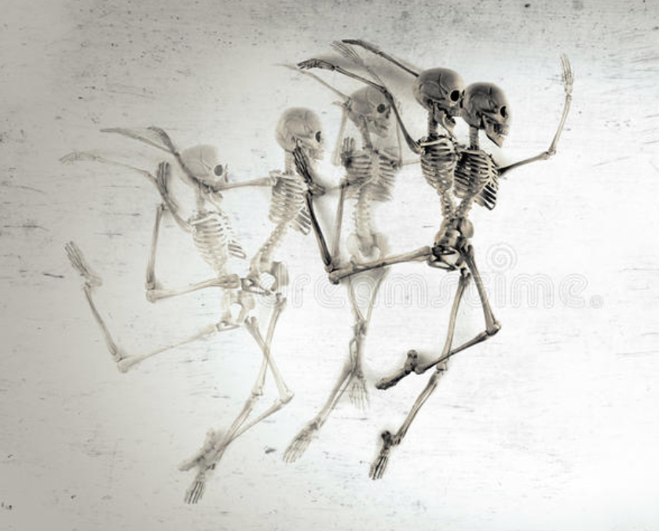
Don’t Abuse your Joints !
They are designed for a lifetime.
Avoid Stretching!
Excessive / Passive Activity will have consequences….
Understanding how to manage the Ramifications of movement.
Train and Move for Life not Instagram!

Slide 12
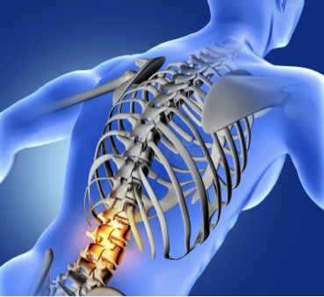
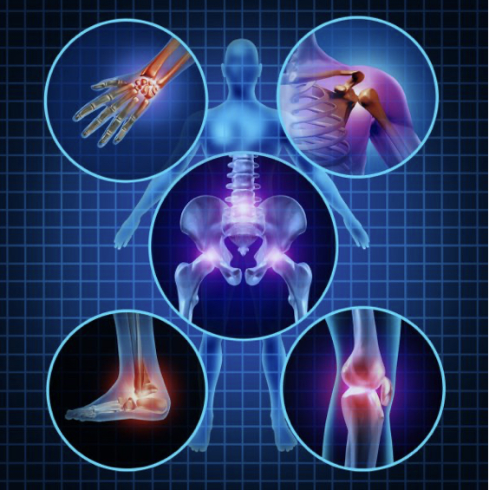
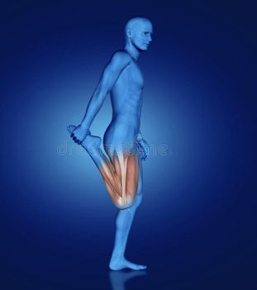
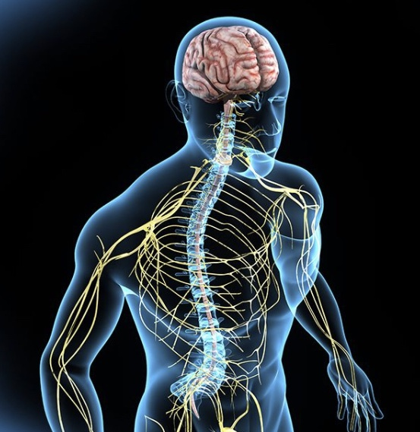
Joint Pains…..
Acute
Chronic
Osteoporosis
Osteoarthritis
Hyperextension
Gout , Degeneration,
Cartilage & ligament Damage
Dislocation & subluxation
Neural
Fracture

Slide 13
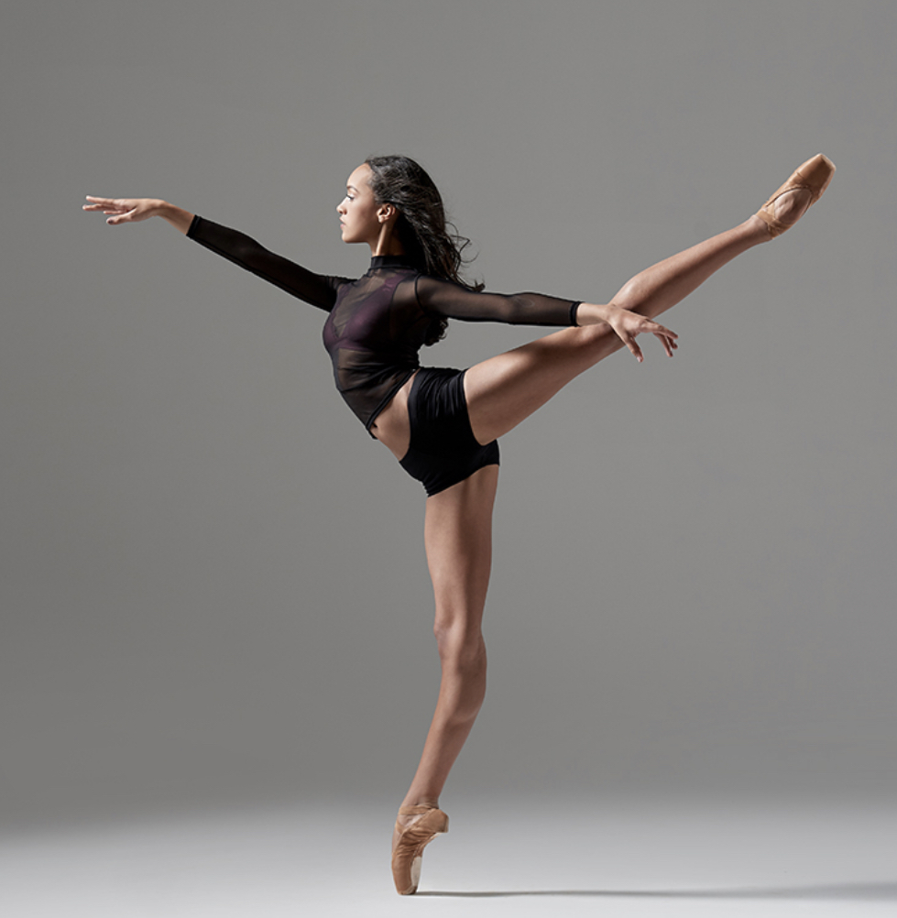
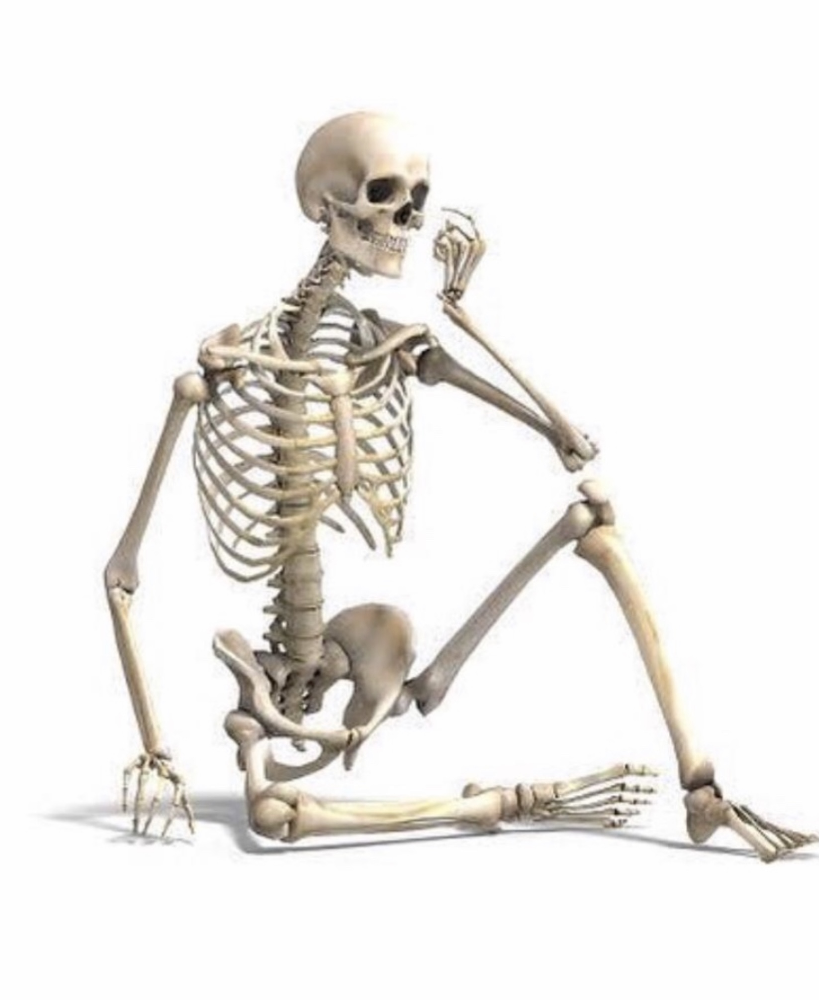
Thanks a Million Thrivers ….
Always Have a Spring in Your Step.

