Slide 1
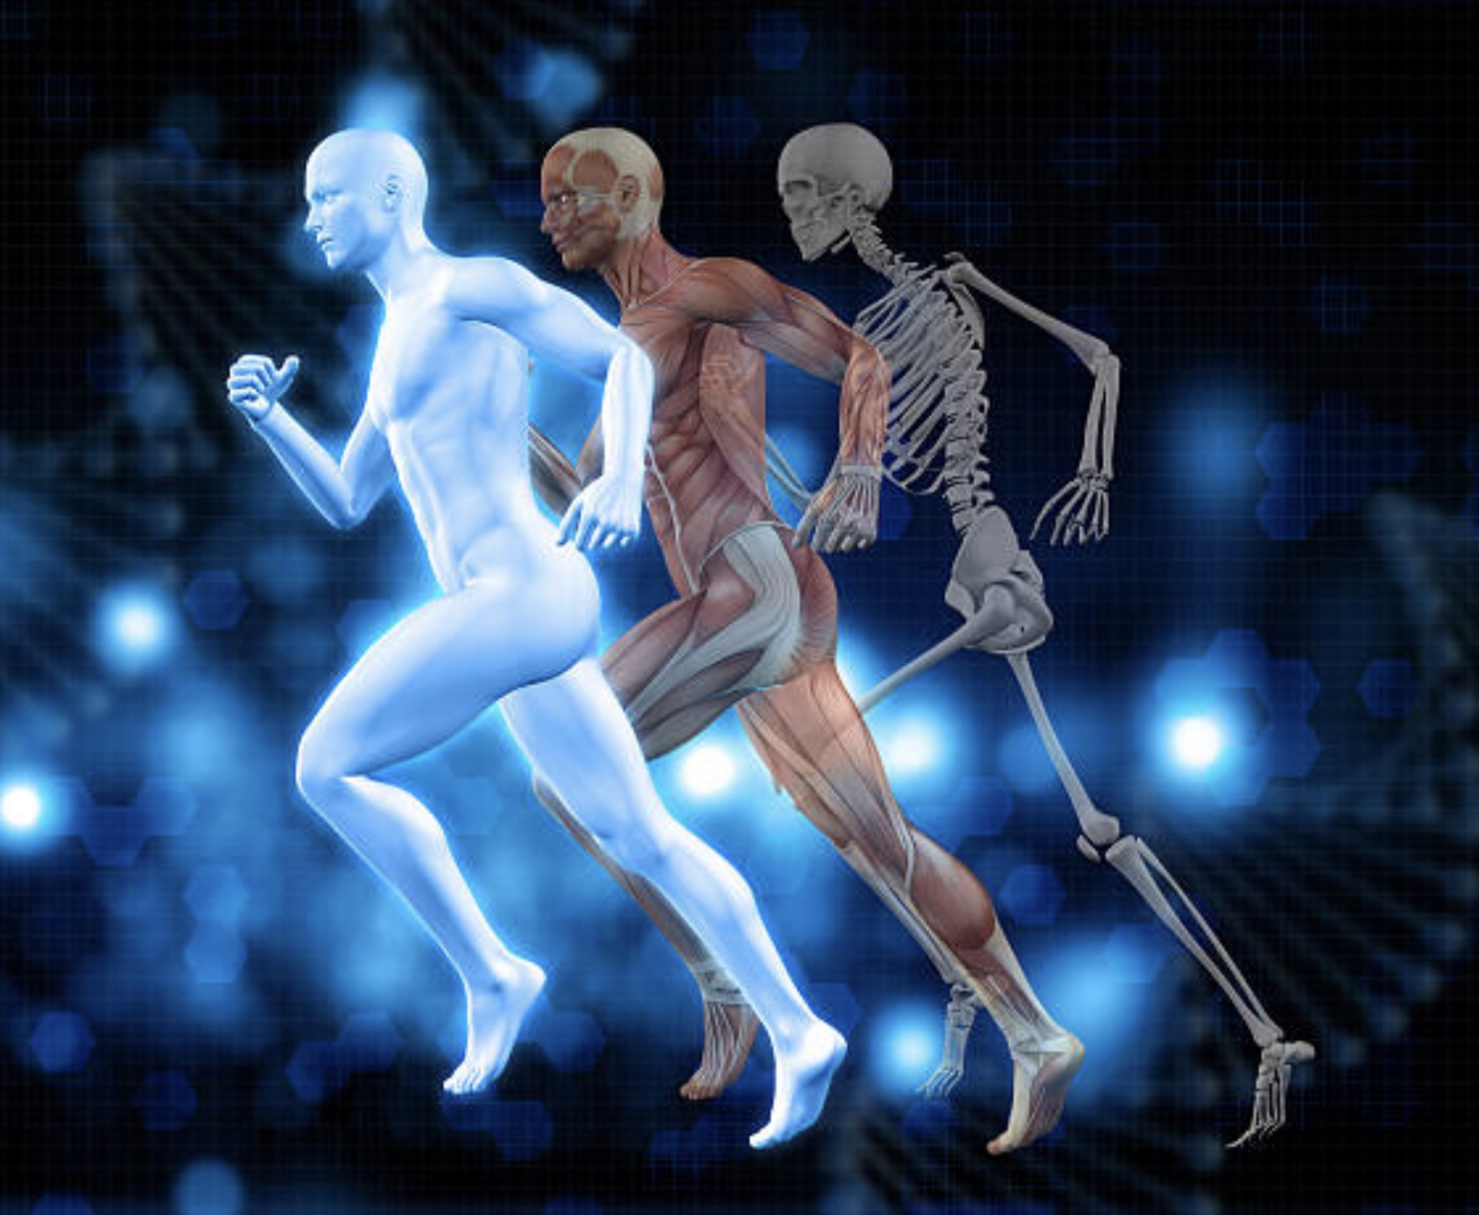
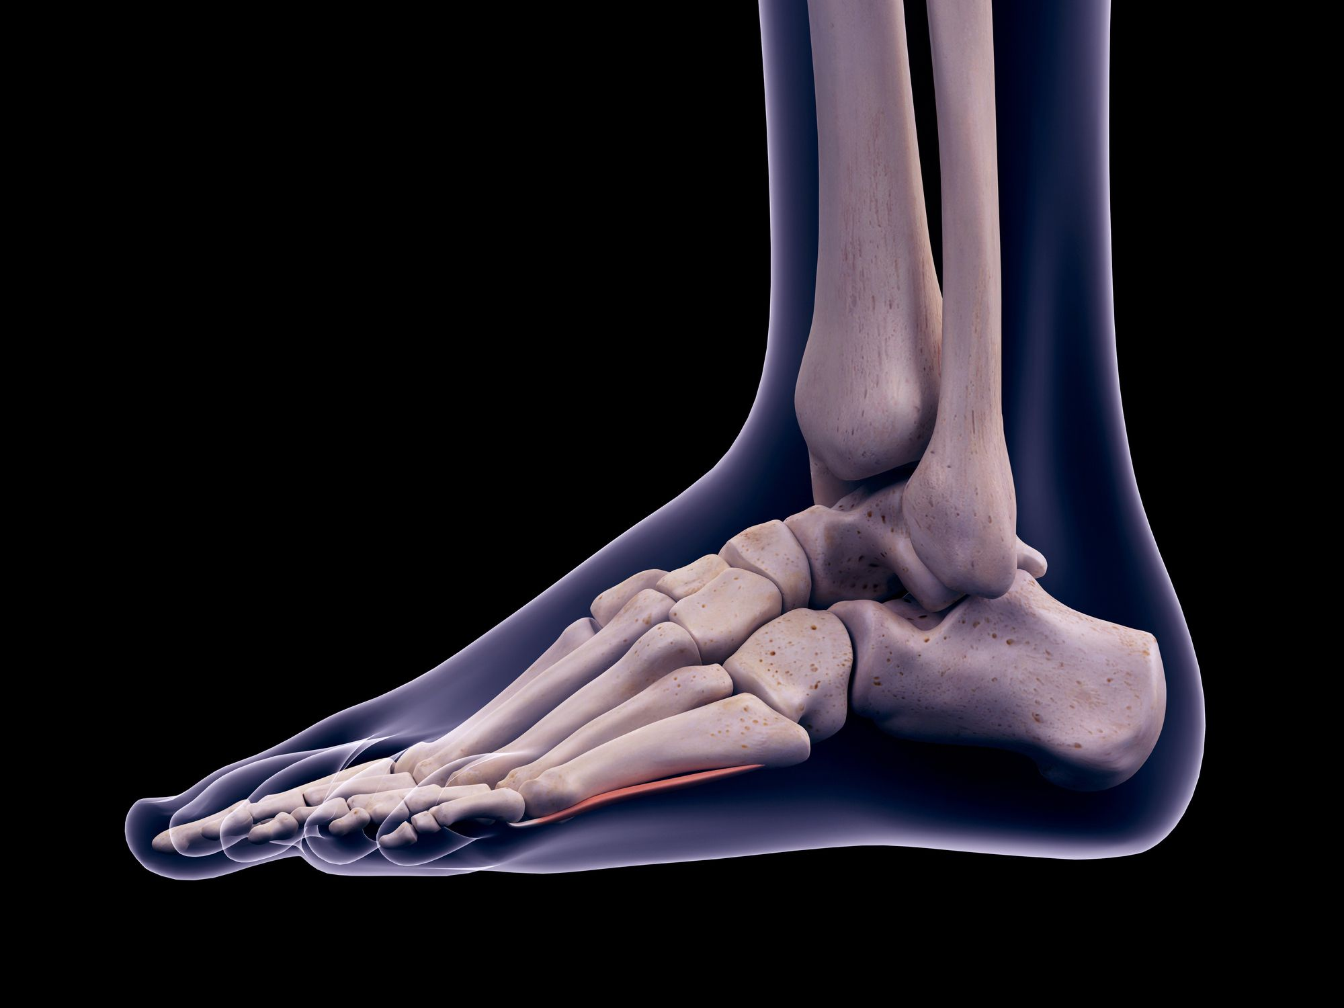
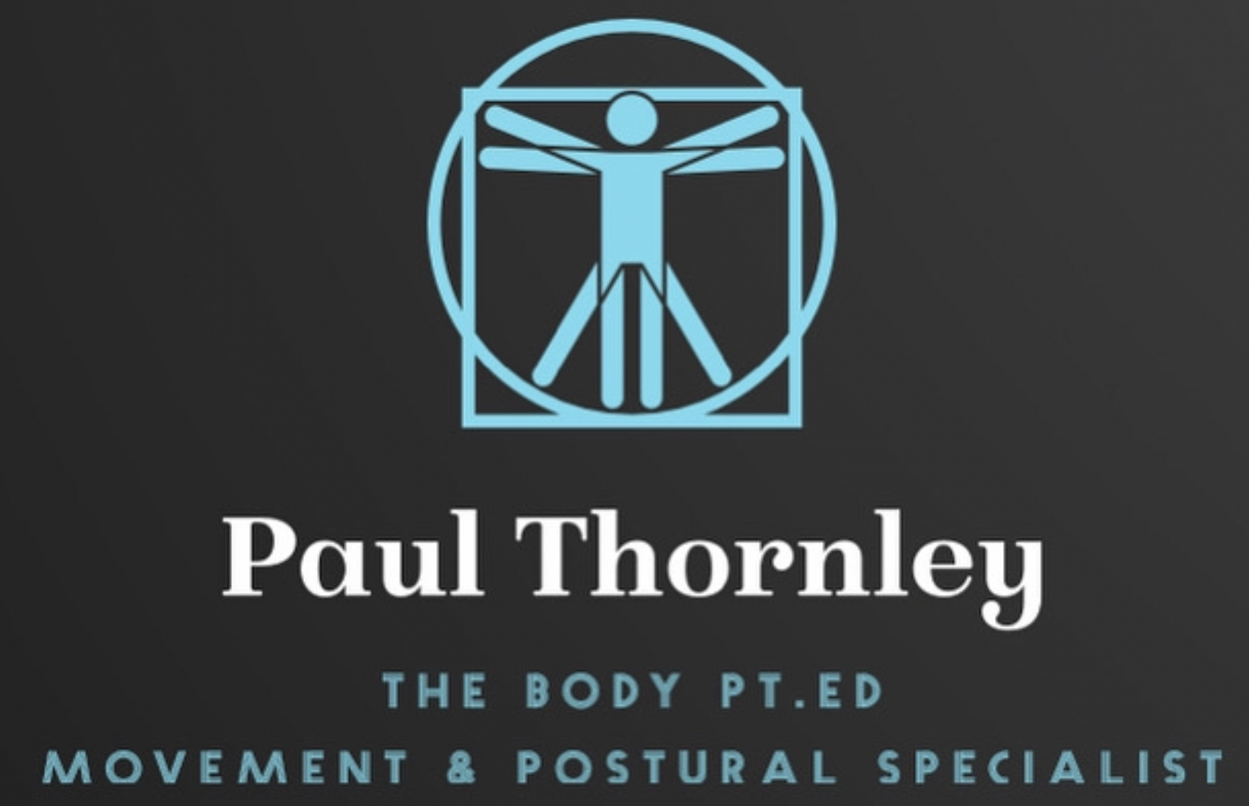
Foot & Ankle
Living Tensegrity in Motion
21st Century Anatomy & Physiology

Slide 2
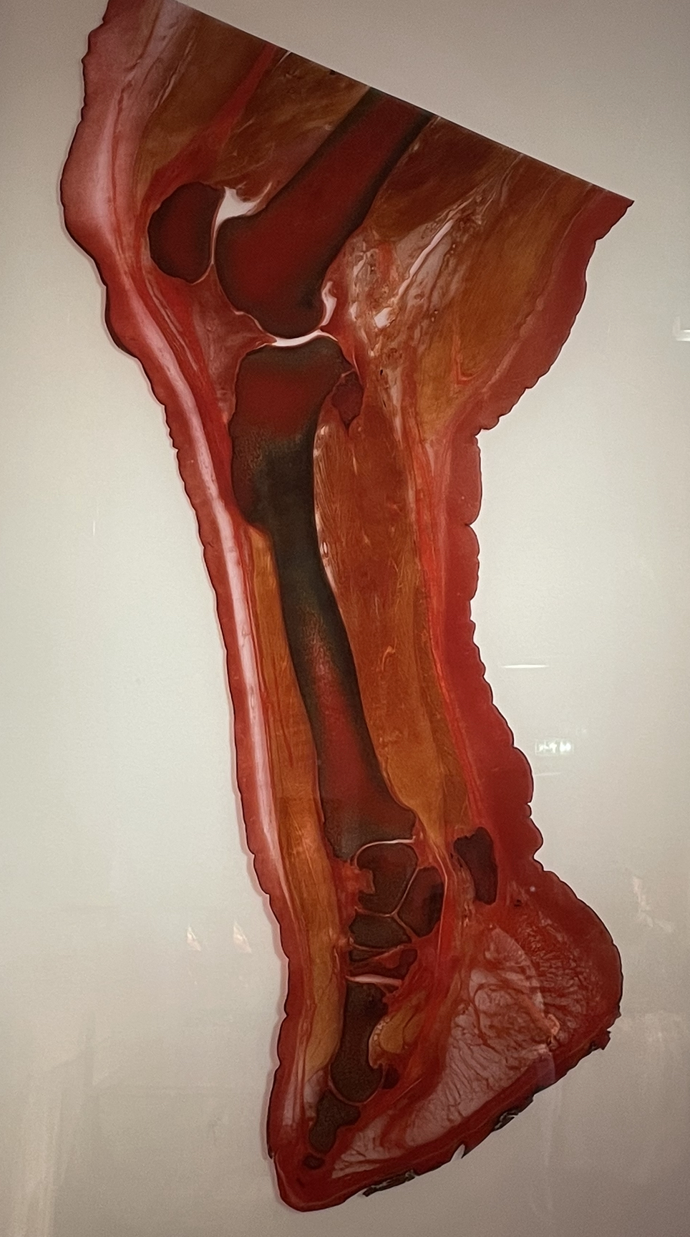
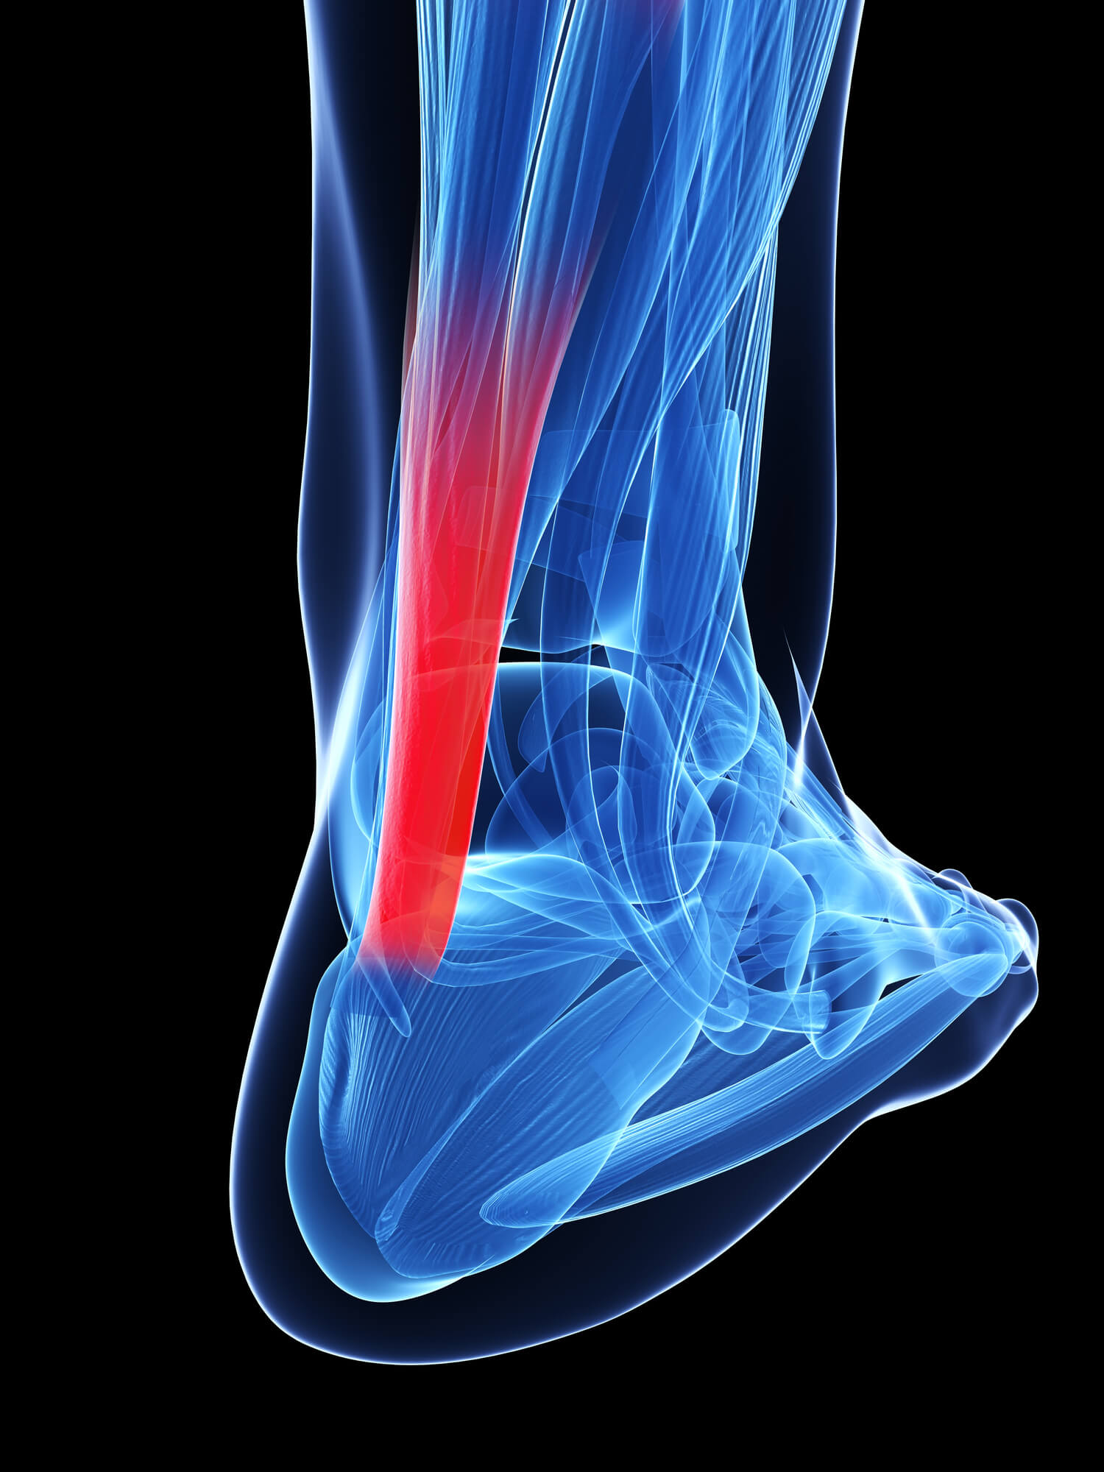
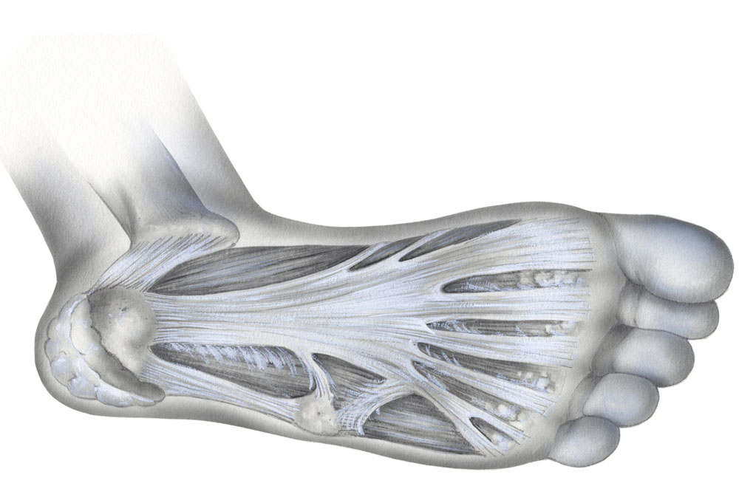
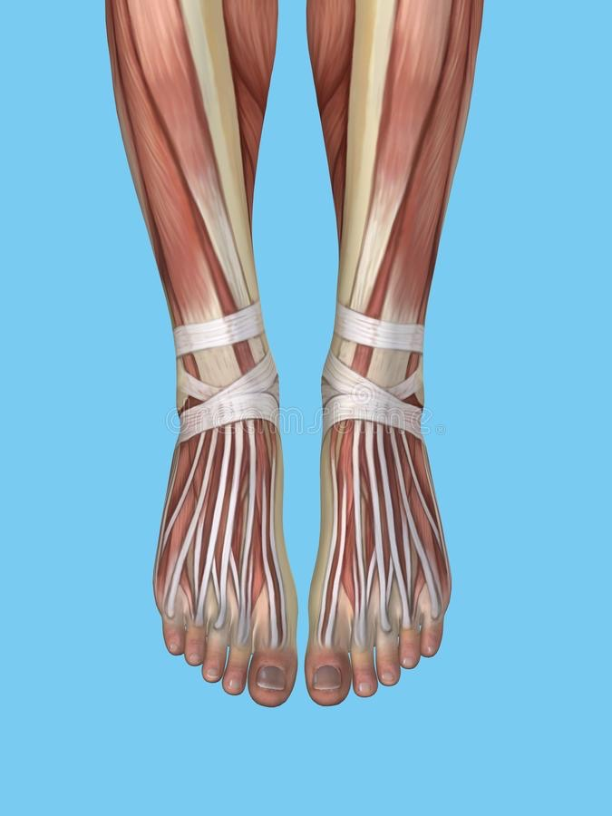
Major Structural Focus!
Why Do our feet require so much attention ?
What benefits do they provide in movements walking & squatting ?
Understanding the Anatomy & Physiology of the foot & ankle during movement, particularly gait, jumping, running & balance etc!
Recognising our common flaws in how we approach training our feet.
Should such emphasis be focused on this particular structure in movement if we’re so dependent on wearing footwear?
How can you achieve longevity & effective life long movements of our feet?

Slide 4
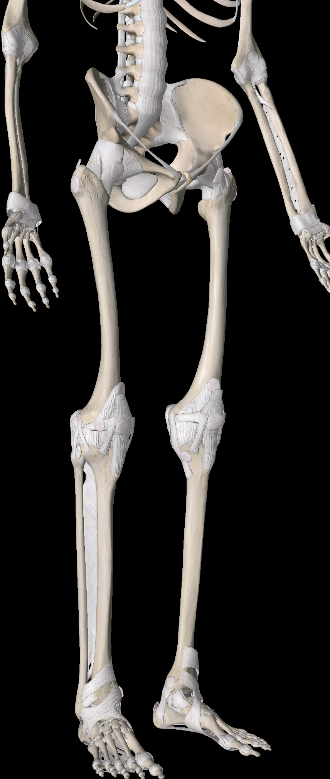
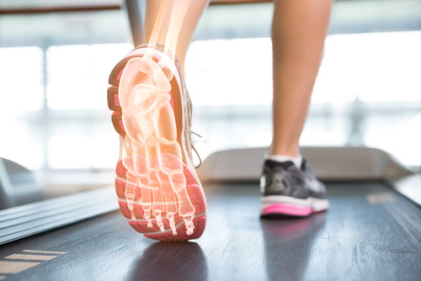
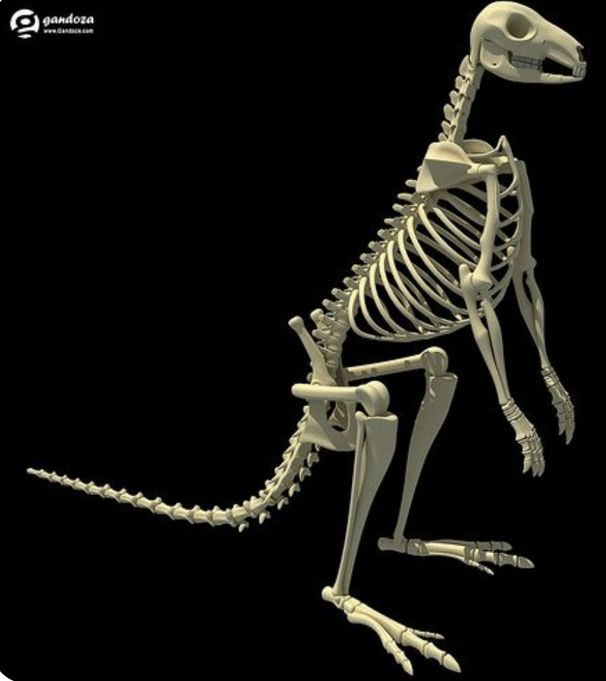
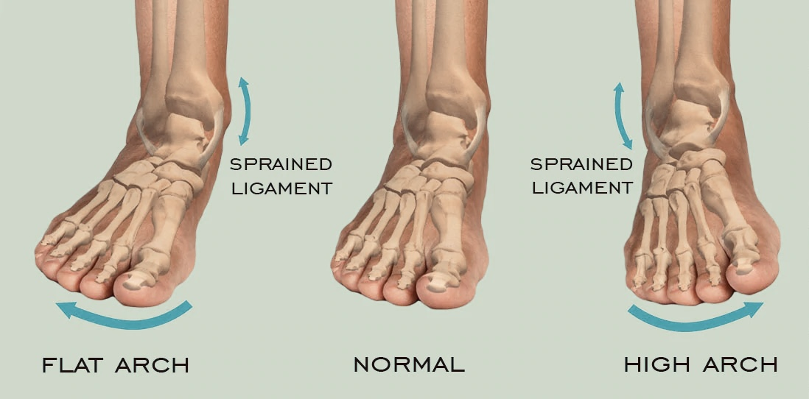
Walking Anatomy Review.

Slide 5
Arthrokinematics.
The angular movement of the bones in relationship to their location.
Movement’s of glide, roll & spin must coexist within the hindfoot,midfoot & forefoot.
Friction Free events must occur within this enclosed environment.
Bones must not collide and clash , virtual space is consistent.
Forces of Living Tensegrity must remain balanced throughout motion.
Compression & Tensional Forces of Opposition support and maintain Structural Integrity.
Pretension is the key to understanding & establishing quality movement.

Slide 6
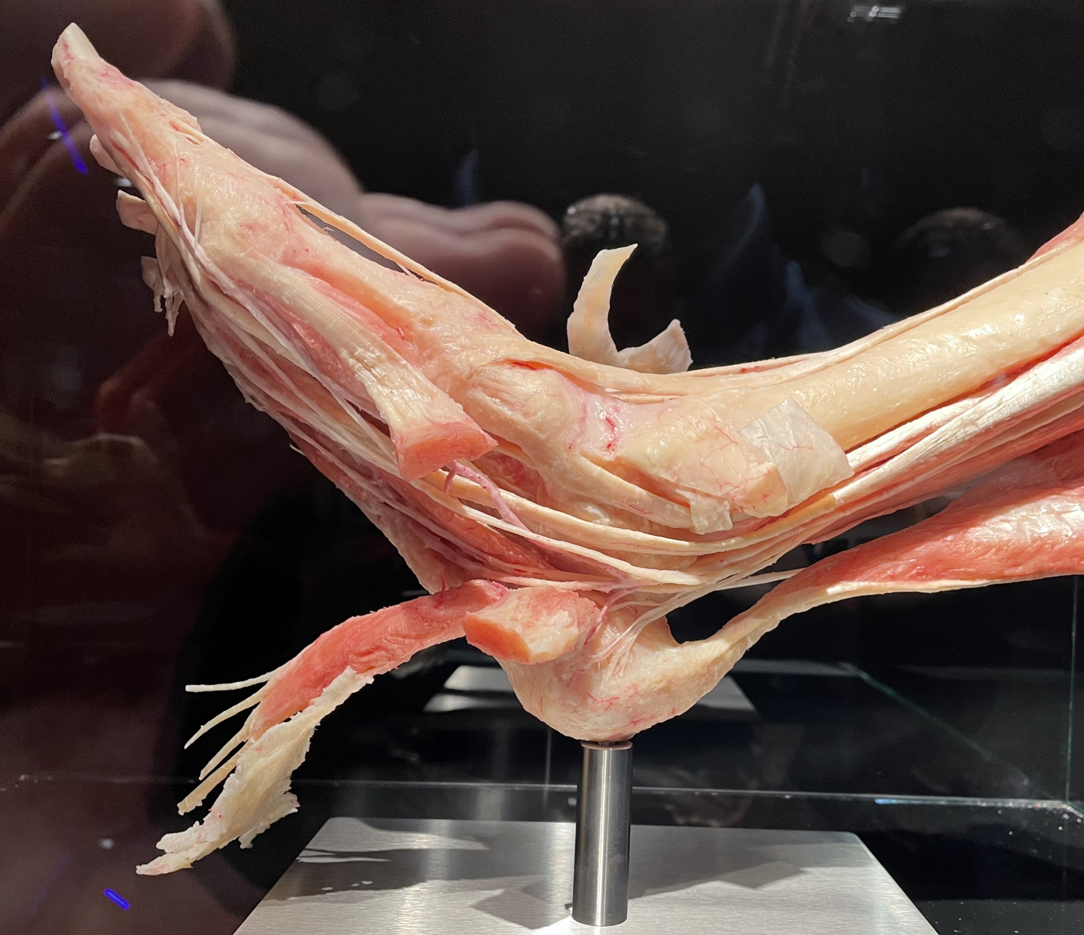
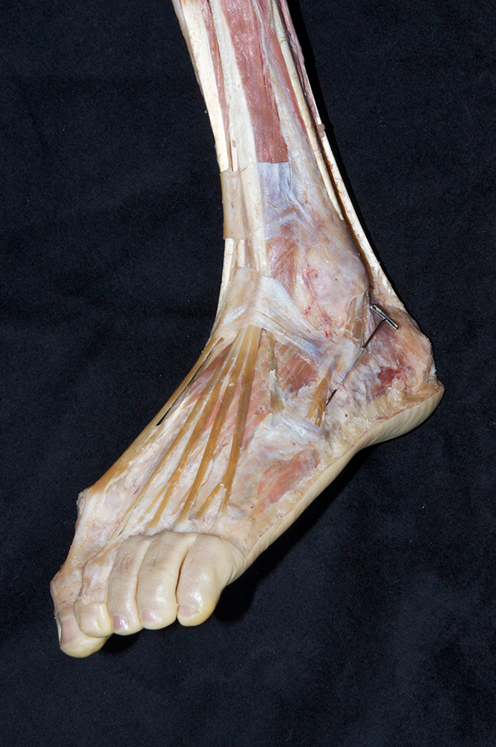
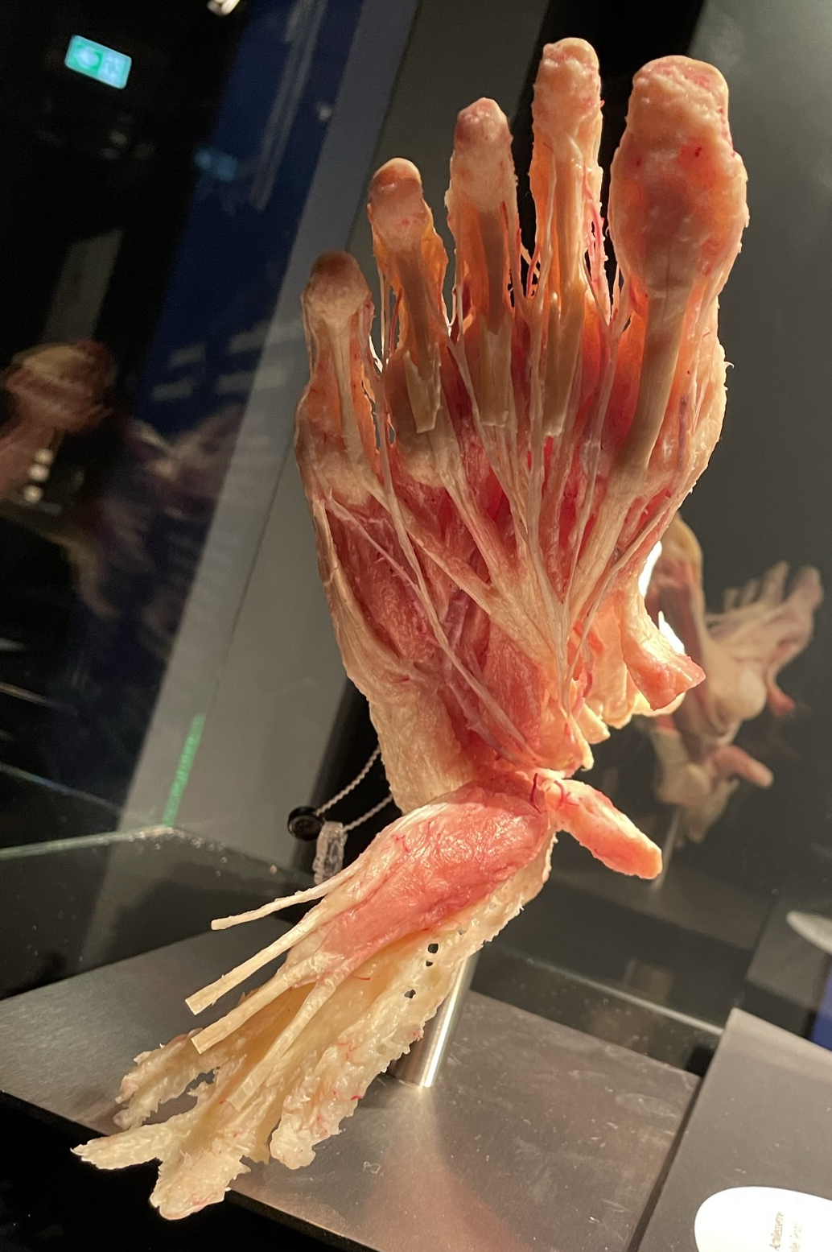
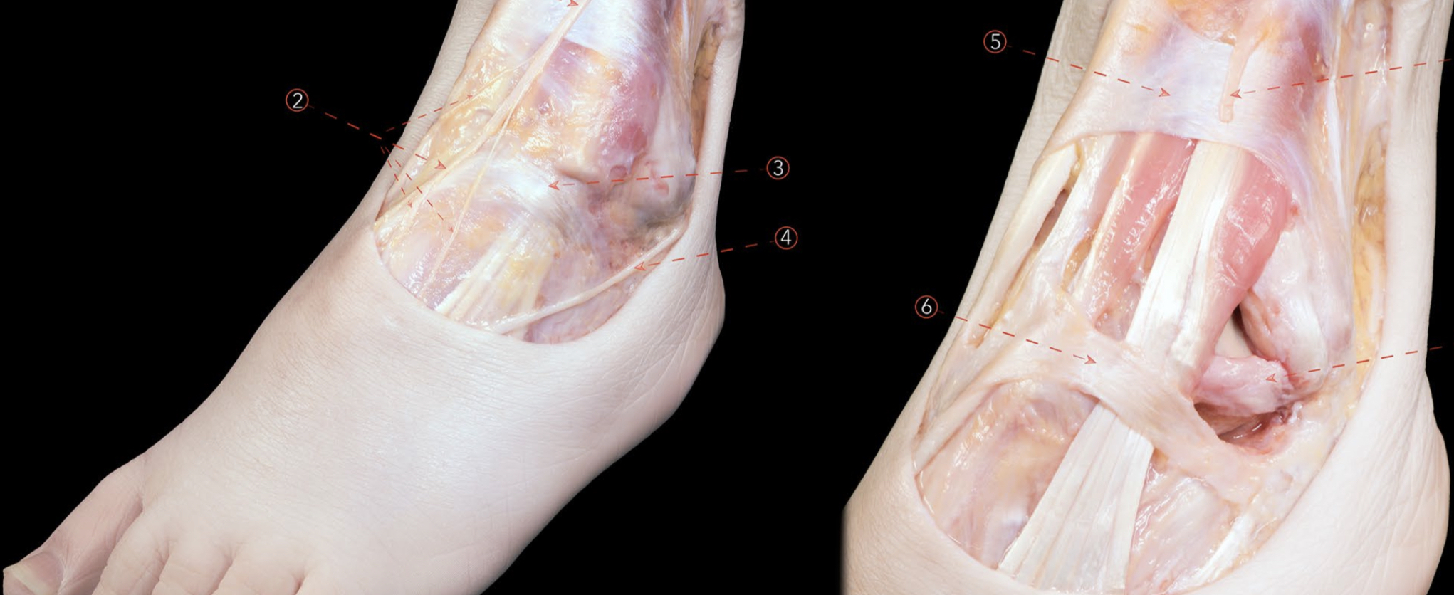
Plantar Fascia & Retinacula
Robust yet incredibly durable….
Strong yet unbelievably Sensitive…
The Quality of this tissue is Paramount to Healthy Motion of your entire body.
Movement is initiated from your feet but is reflected in the adaptability & positioning of your head,jaw & cervical.

Slide 8
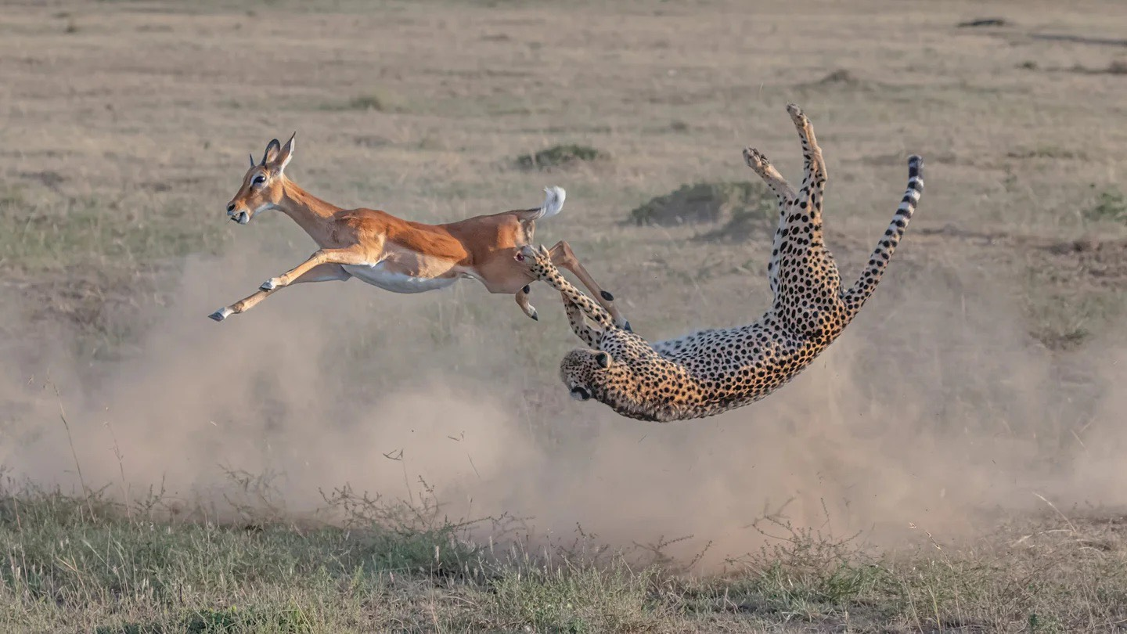
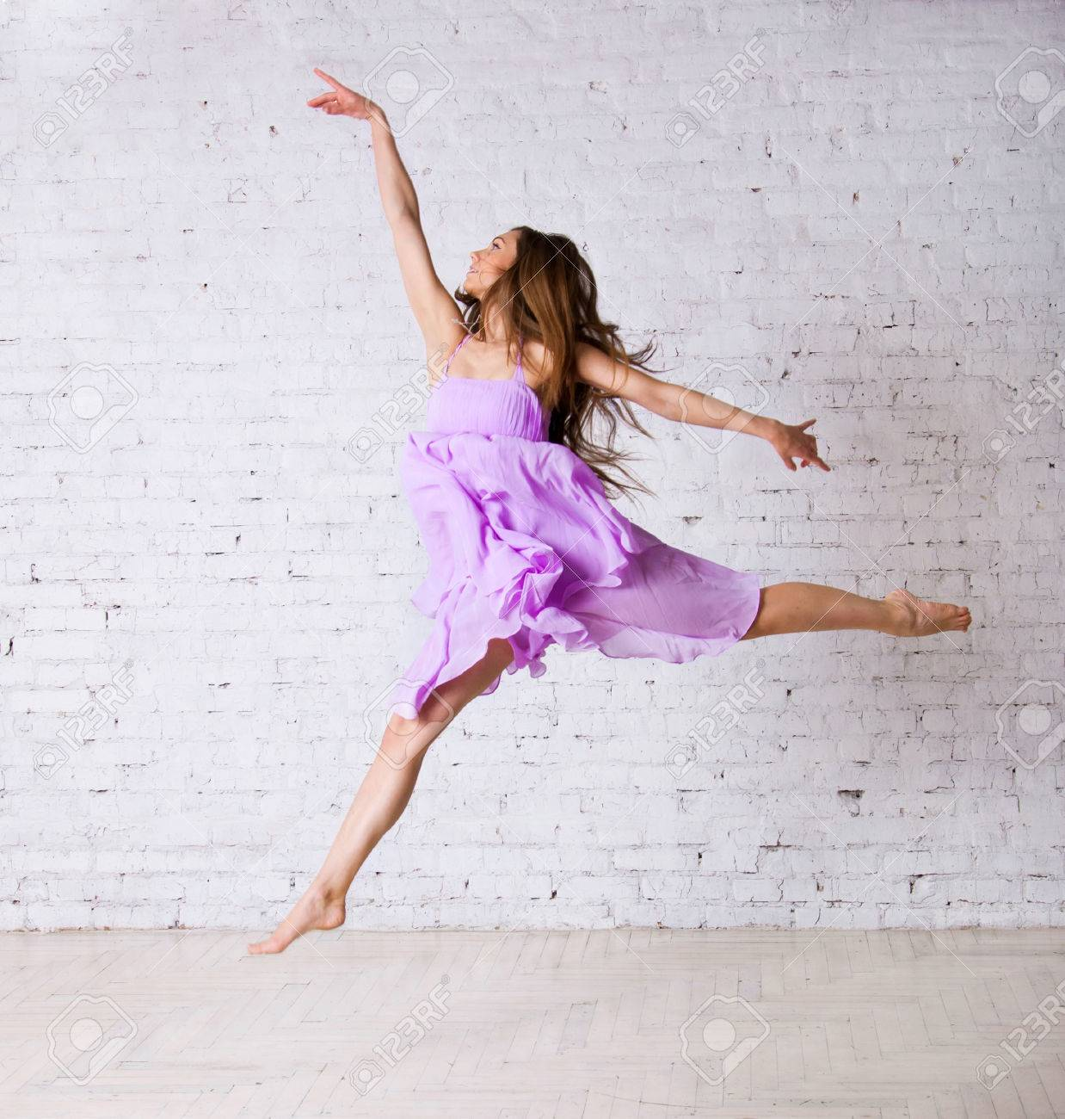
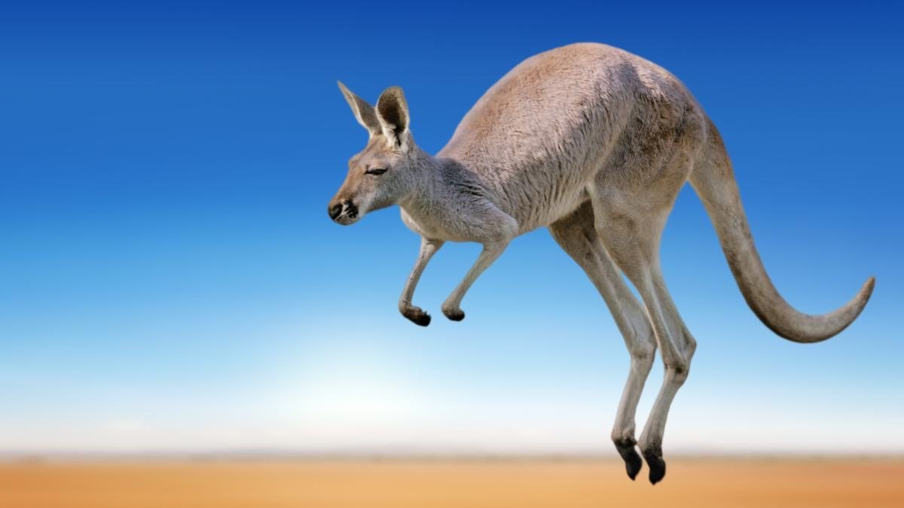
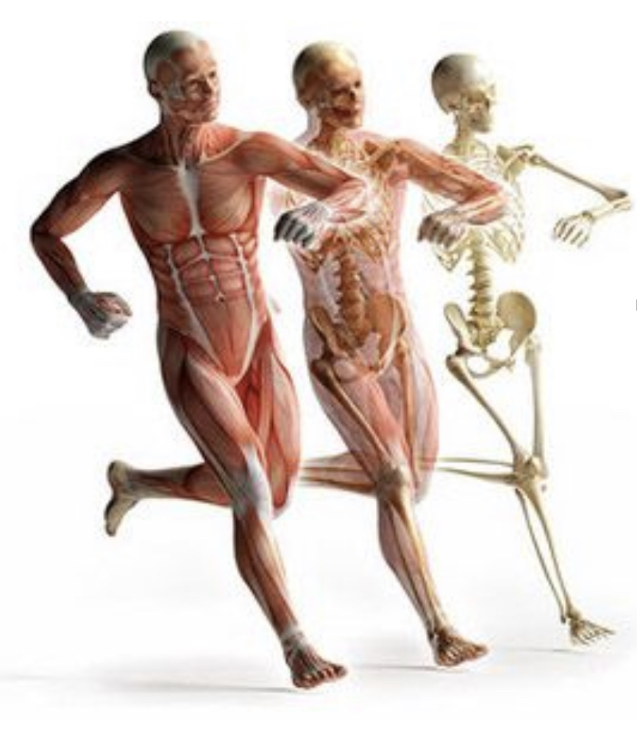
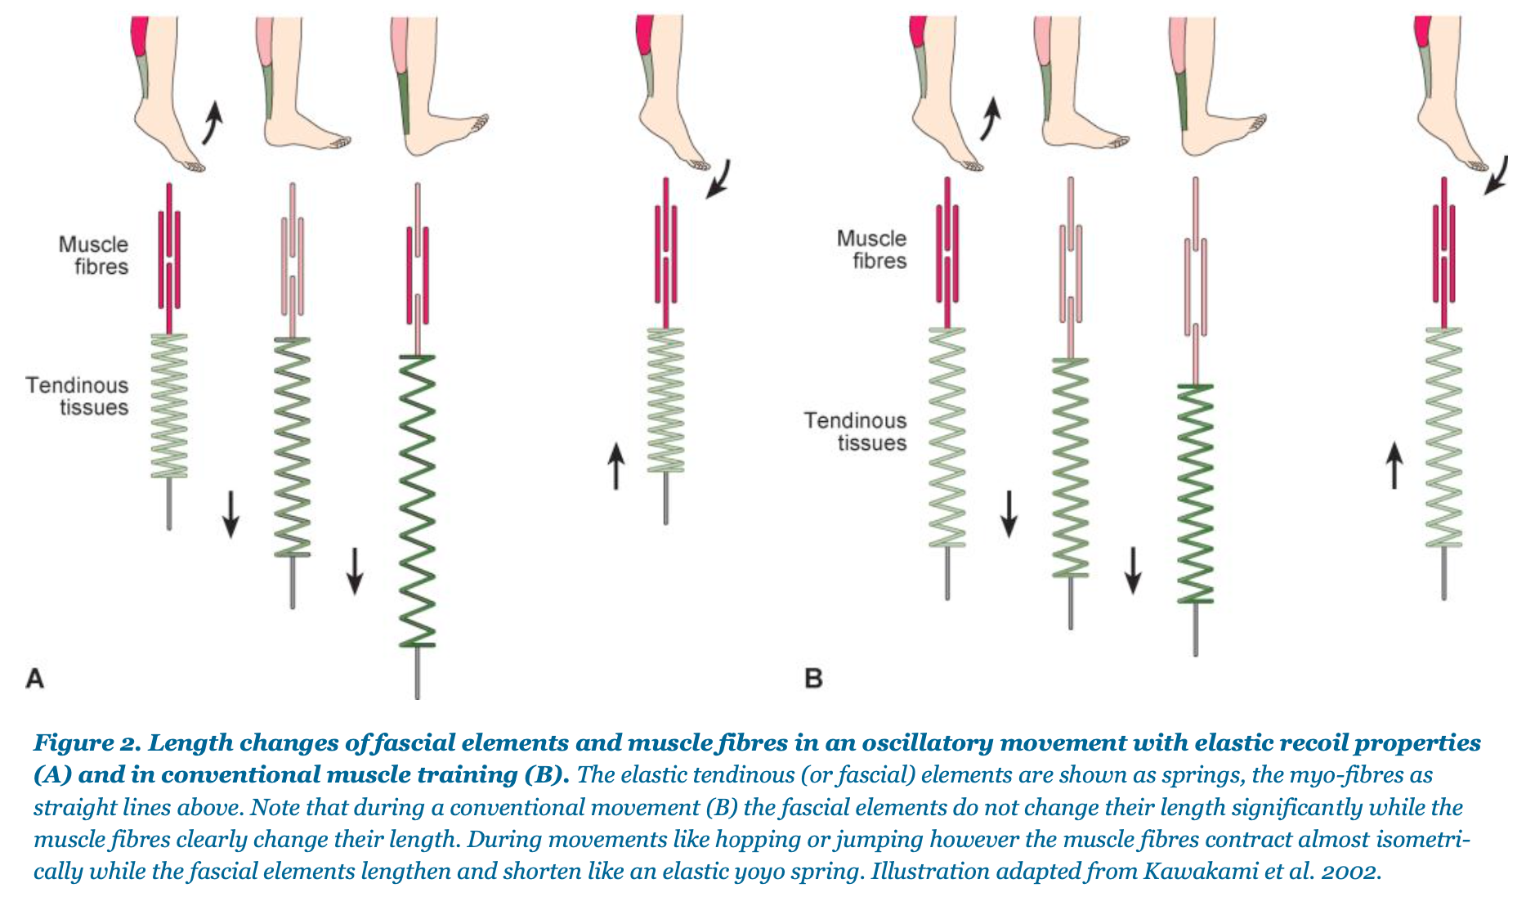
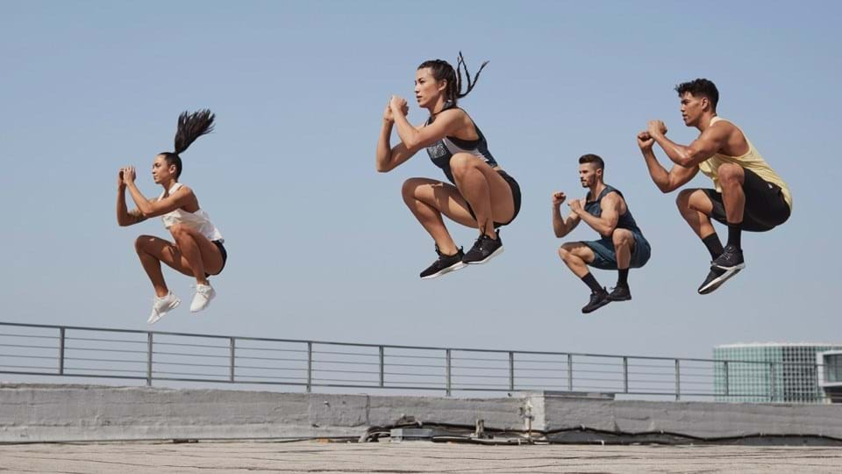
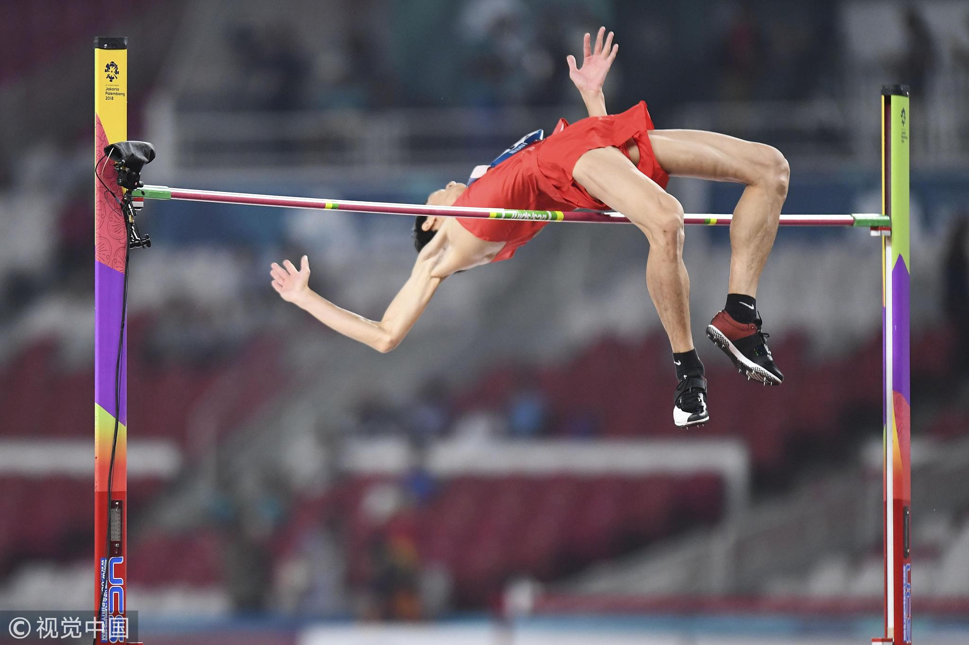
Elastic Recoil & Spring Systems.

Slide 9
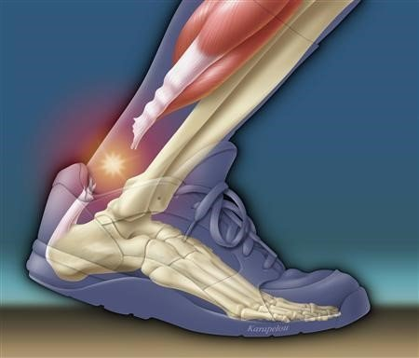
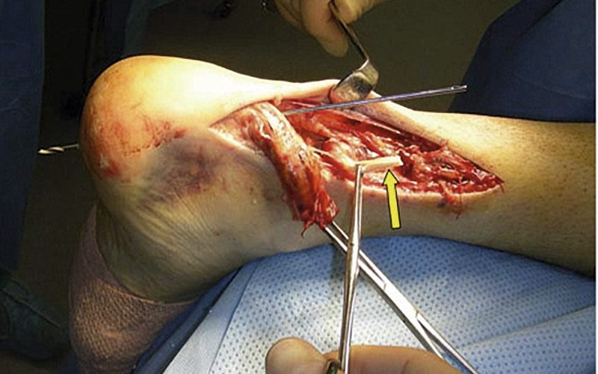
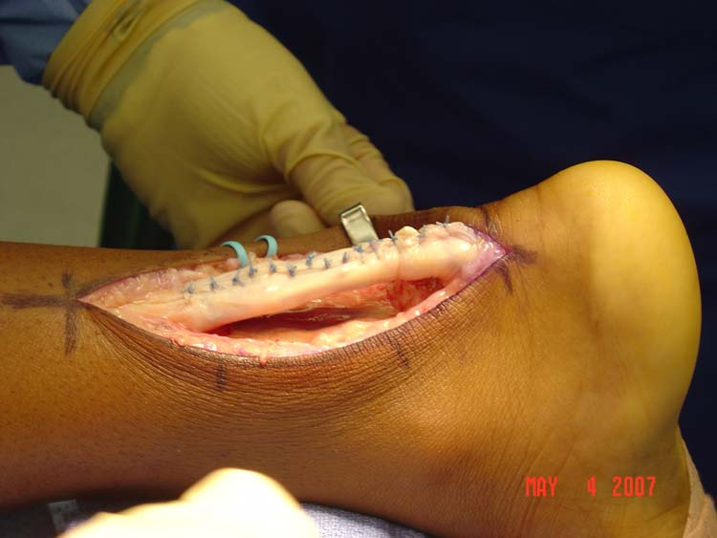
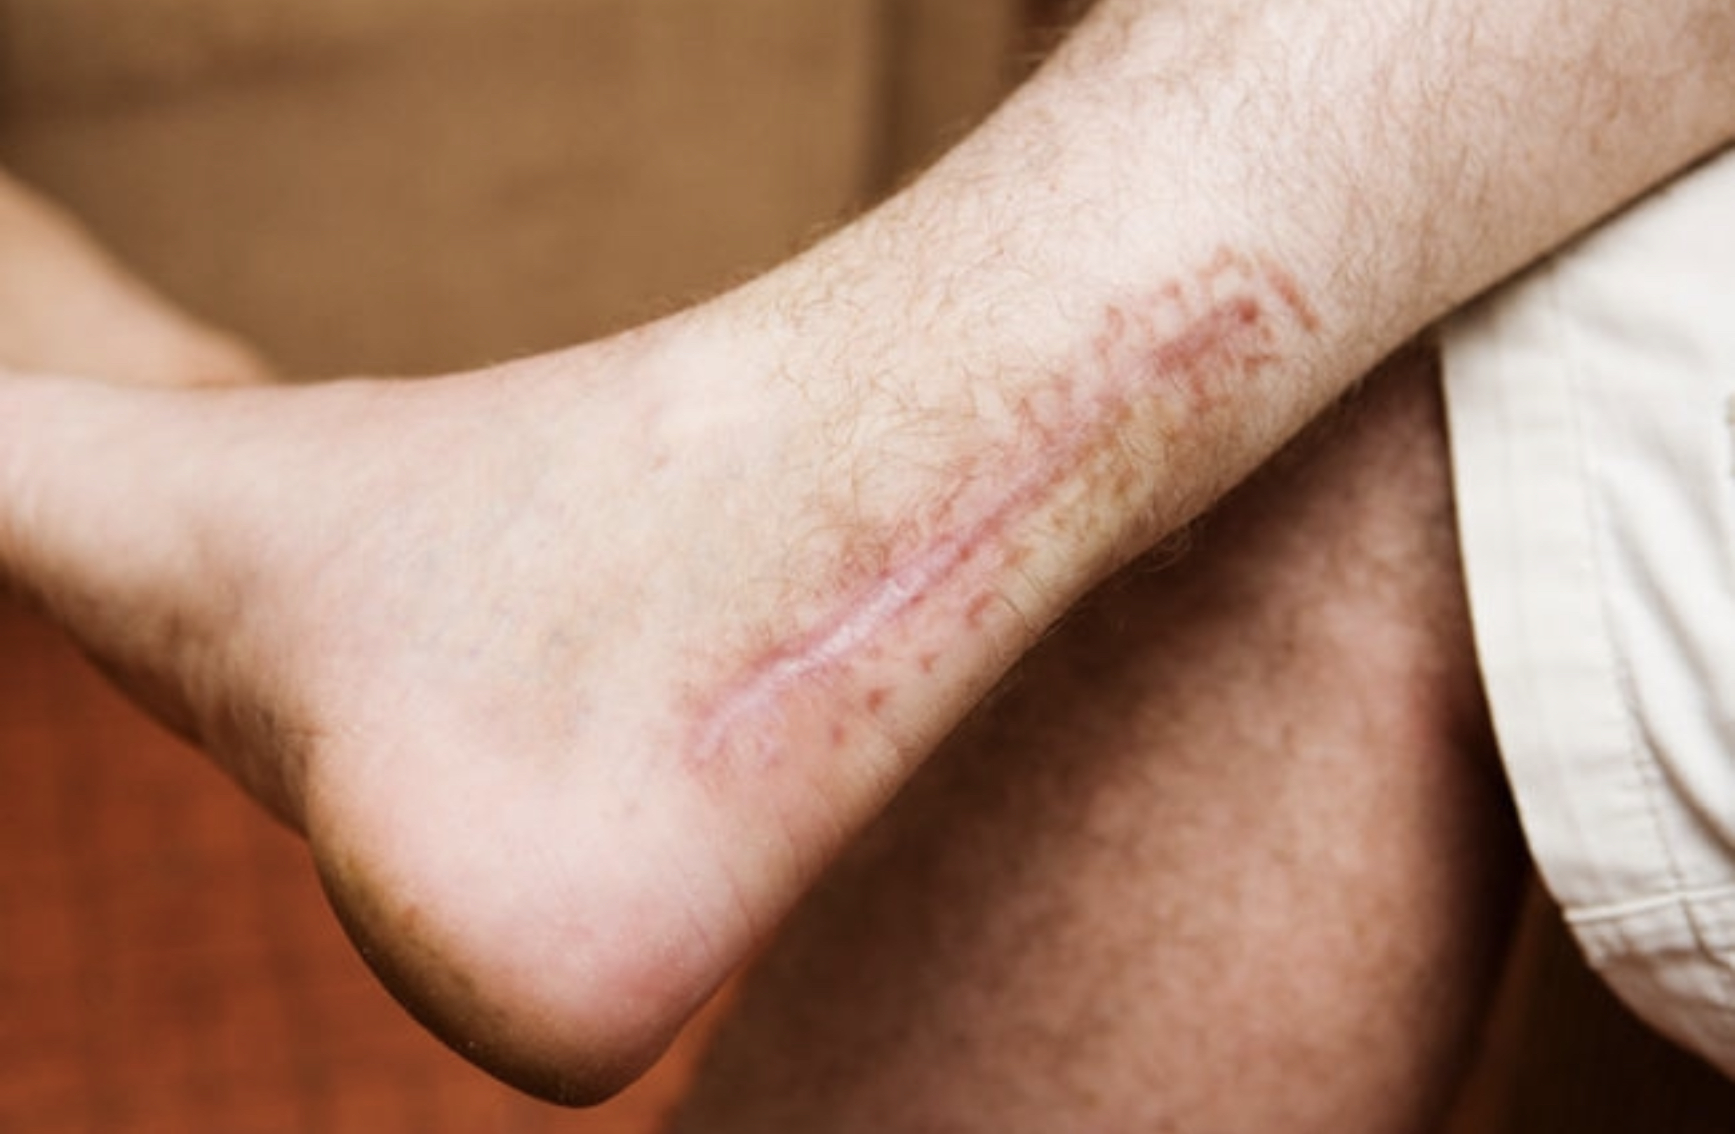
Fasciategrity & Living Tensegrity in Motion goes Wrong!
Neglecting the Feet…
Over Training & Damaging the Tissue…
Stretching…..
Poor Jumping & landing
Trips & Falls
Not Moving like Human!
Shoes & Flip Flops

Slide 10
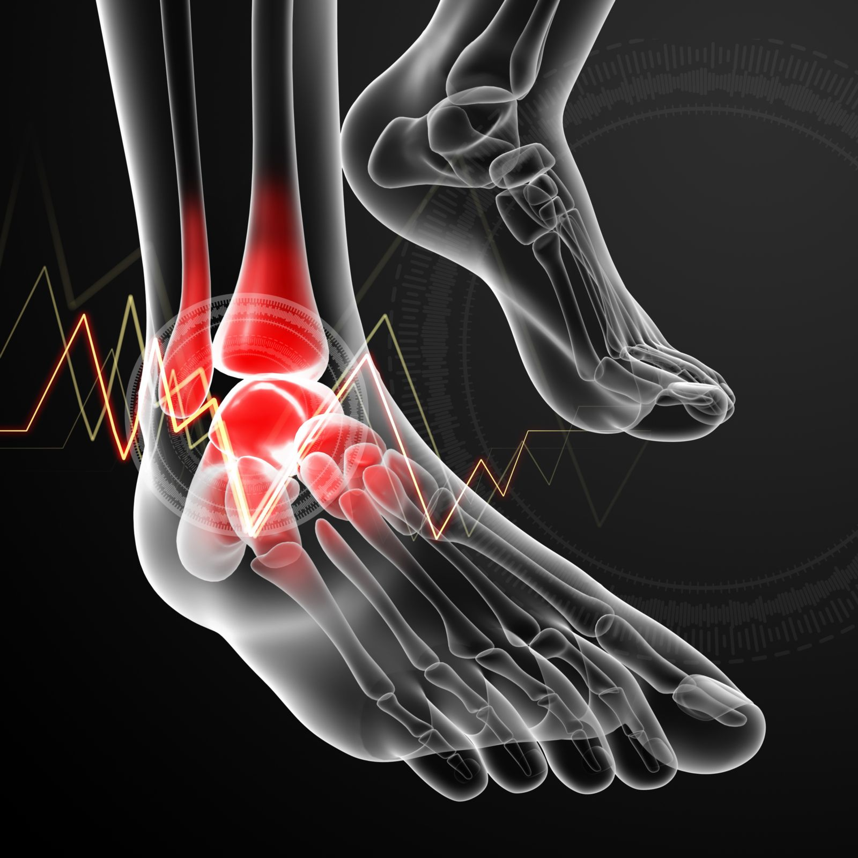
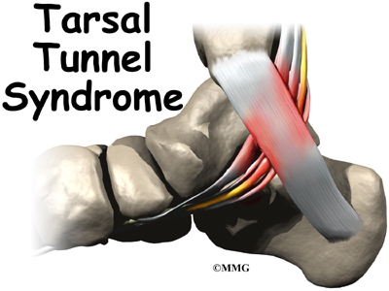
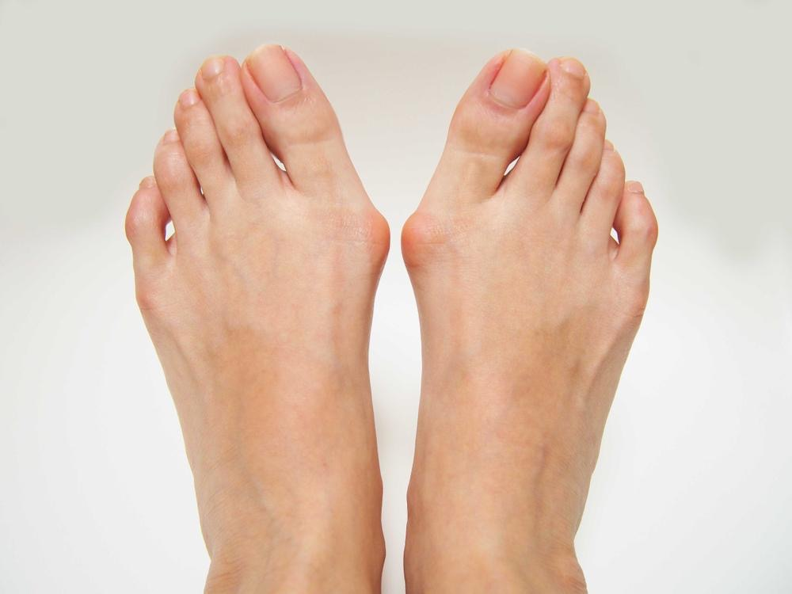
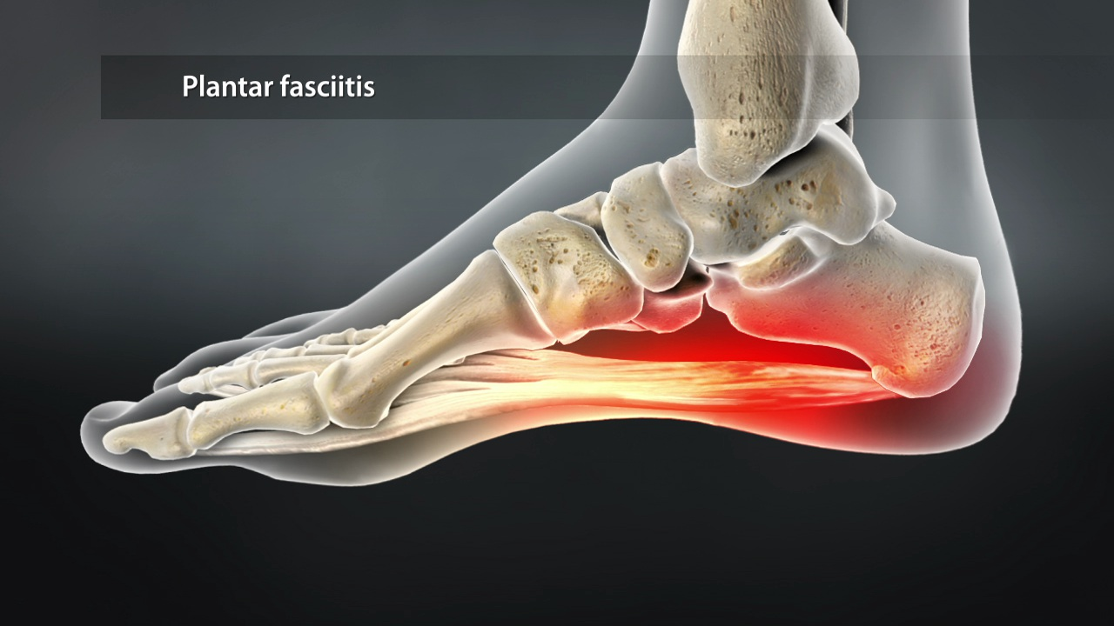
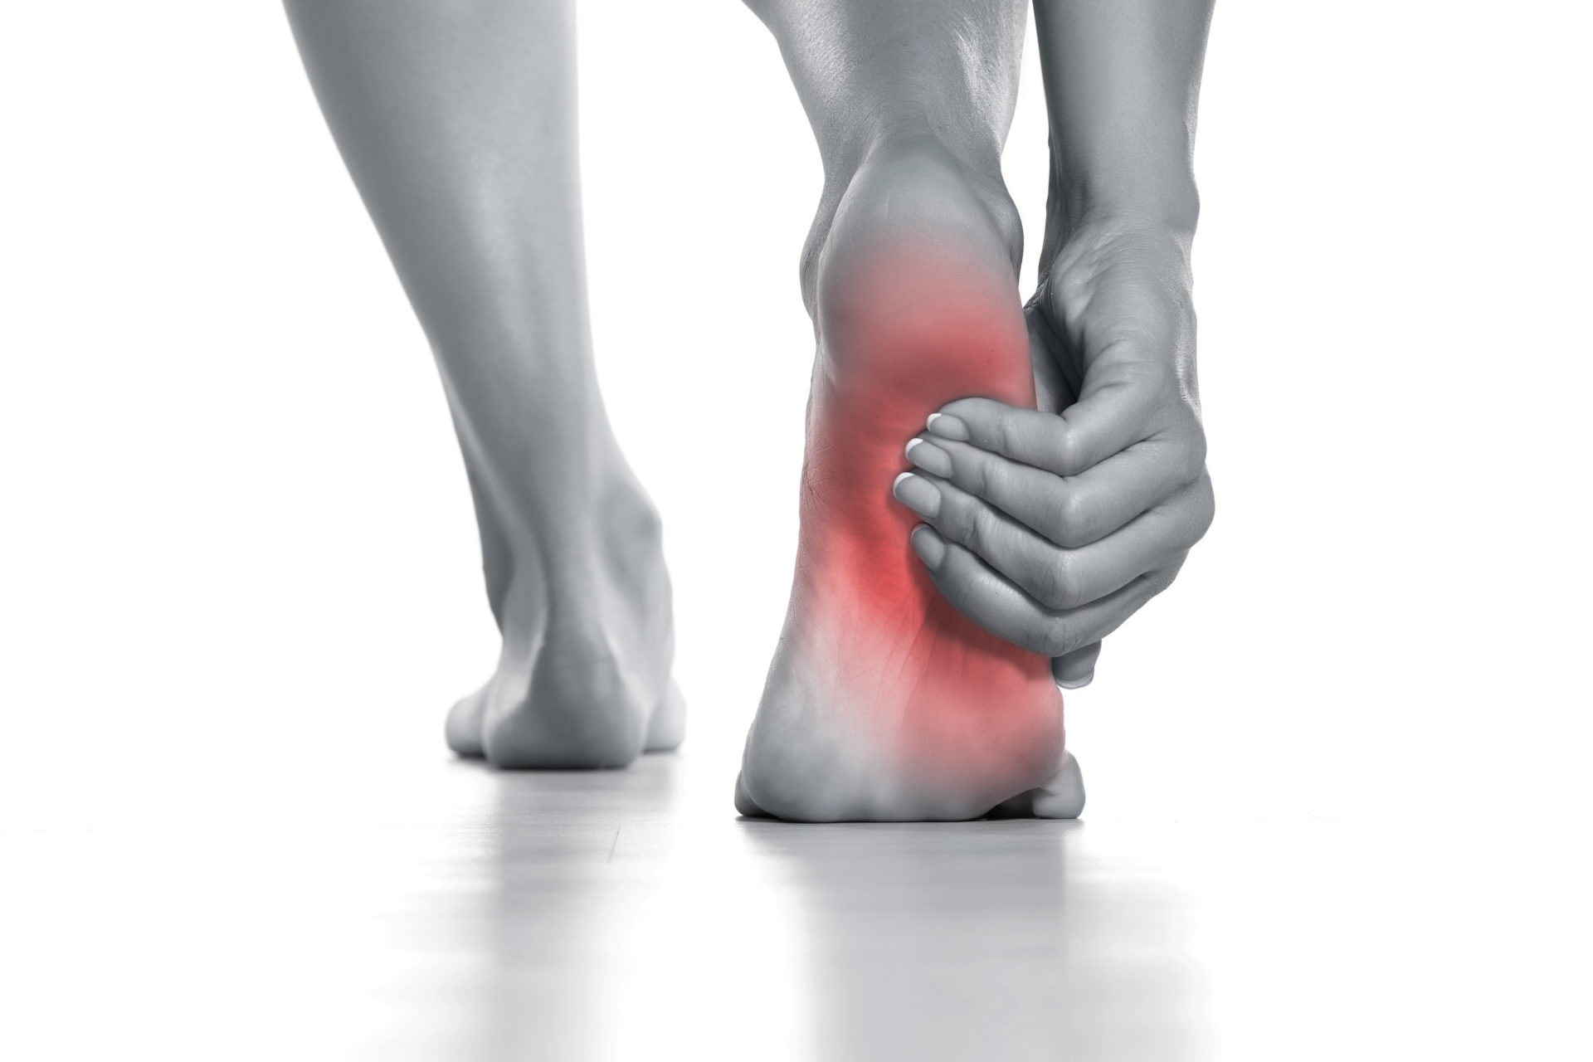
Most Common Feet & Ankle Issues .
Bunions
Ingrown Toenail’s
Corns & Calluses
Tassel Tunnel Syndrome
Plantar Fasciitis
Achilles Tendonitis
Osteoarthritis
Morton’s Neuroma

Slide 11
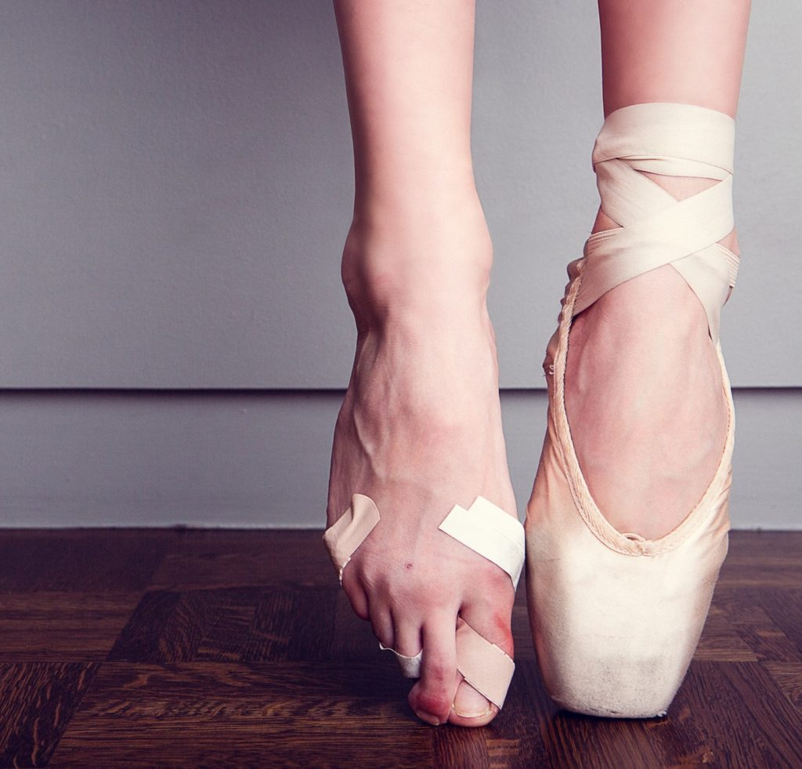
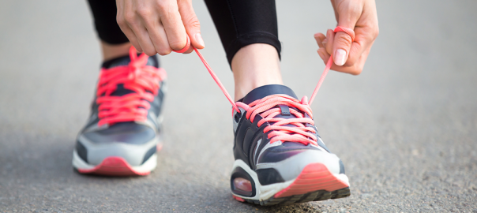
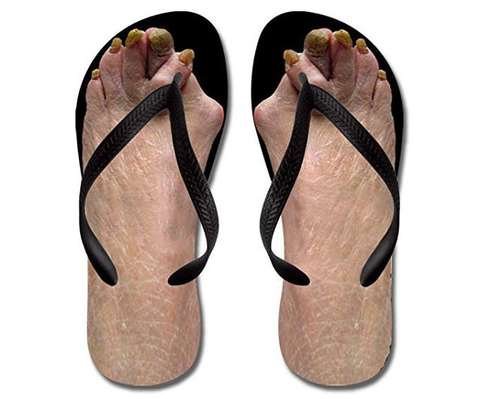
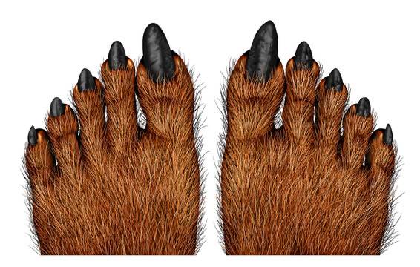
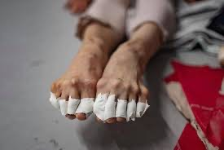
Shoes !
Avoid poor distribution of forces through your feet.
Ensure your heal is connected to the shoe!
Stride rather than drag your feet.
Movement should be smooth & effortless.
Springy & Bouncing actions are paramount to ensure longevity.
Low load and progress to high load as appropriate when reeducation of feet is necessary.
Remember… Exercise Physiology & life Physiology Don’t always reflect or support one another.

Slide 12
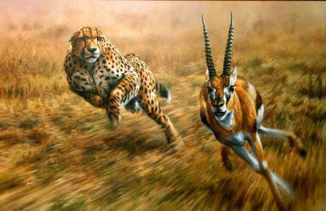
Understanding
21st Century Structure & Functionality
Helping Create Extraordinary Instructors
The Foot & Ankle
Fasciategrity & Living Tensegrity in Motion
Thank you !

