Slide 1
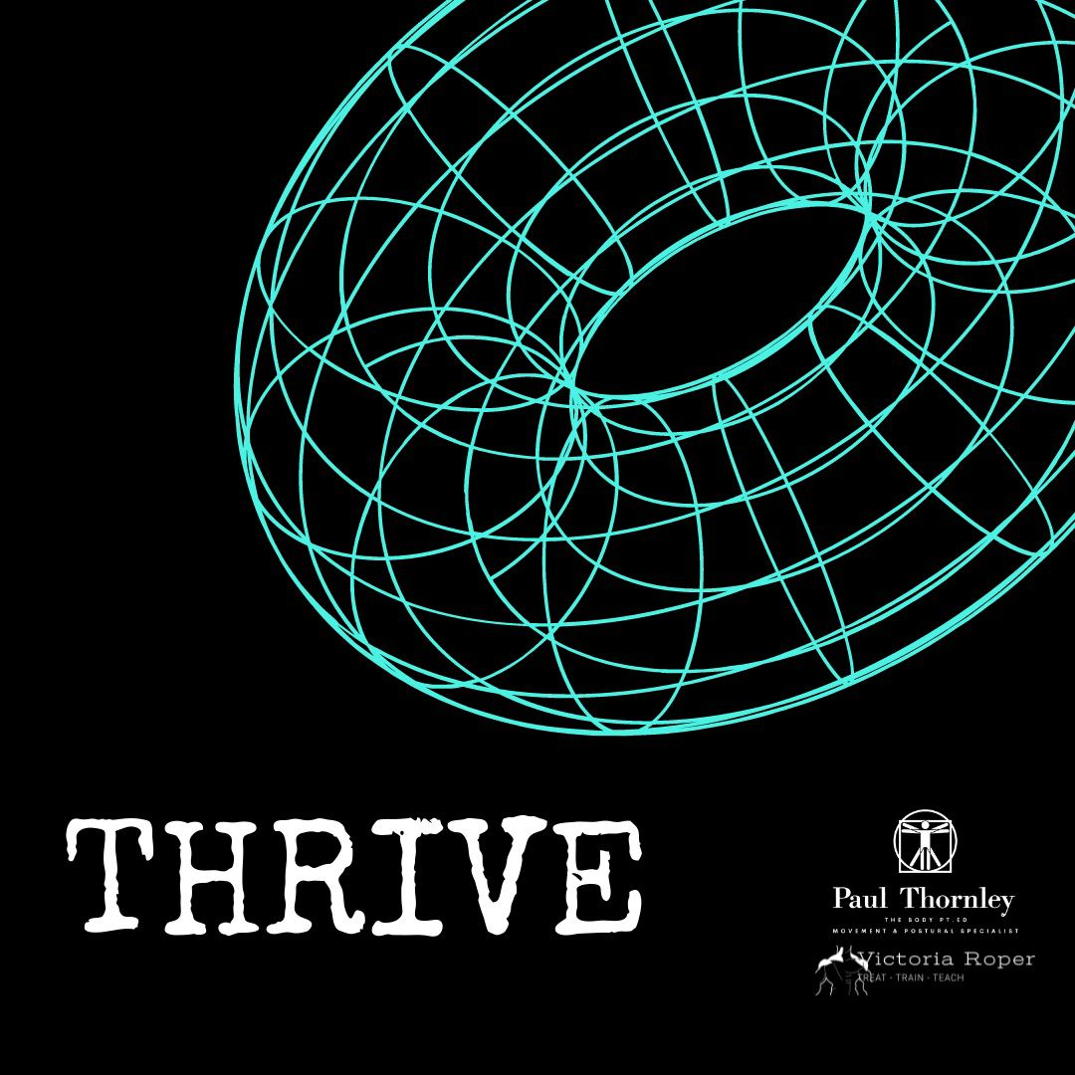
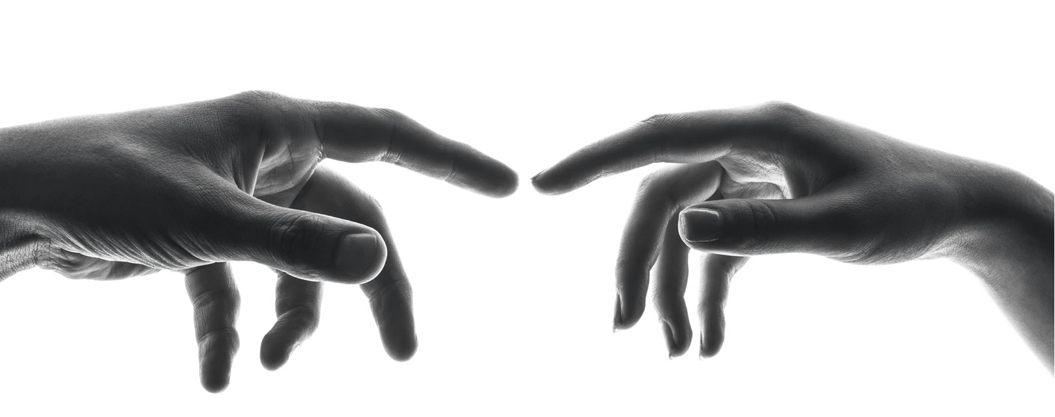
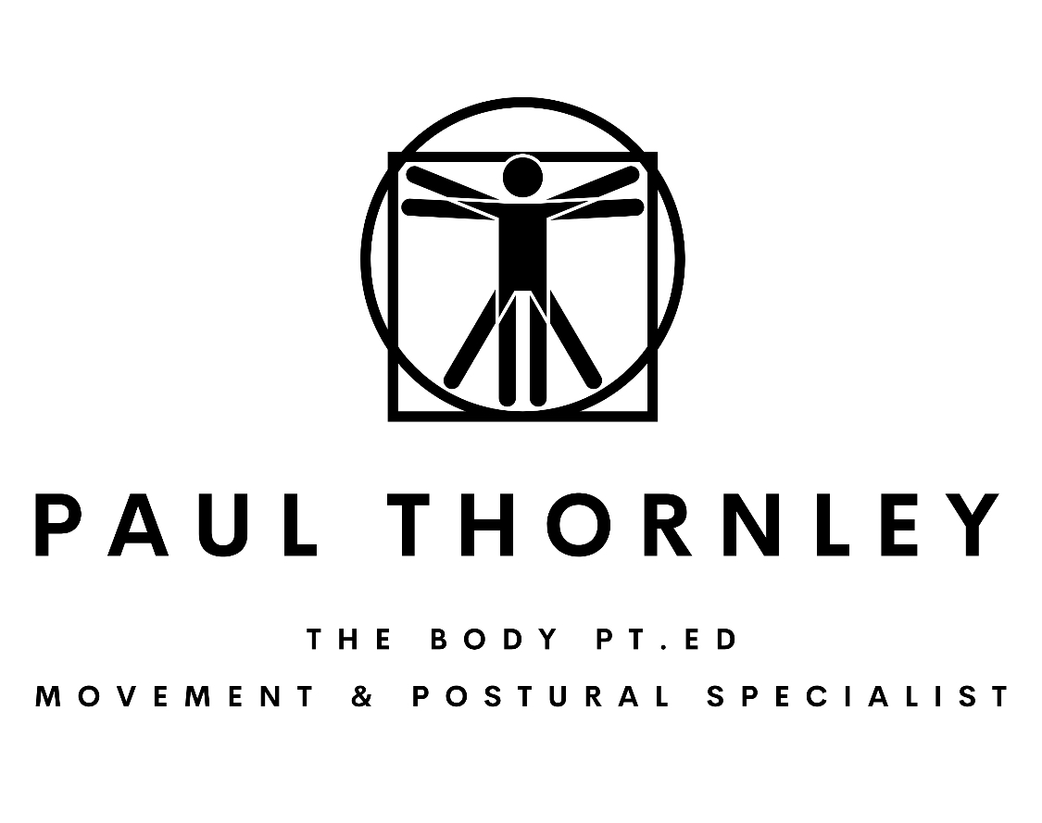
Palpation & Skin
21st Century Anatomy & Physiology
Living Tensegrity & Fasciategrity in Motion

Slide 2
The Art of Palpation
Why do we touch?
What are you actually influencing when you touch?
How to apply effective palpation
Should we utilise this as often as we do?
Clients experience of contact

Slide 3
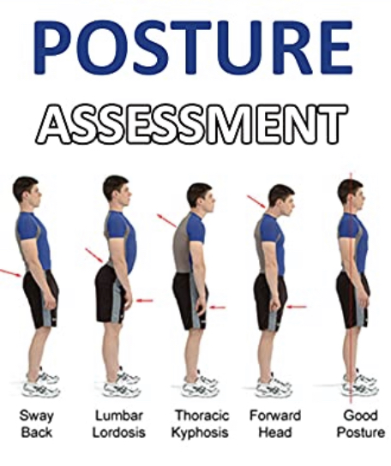
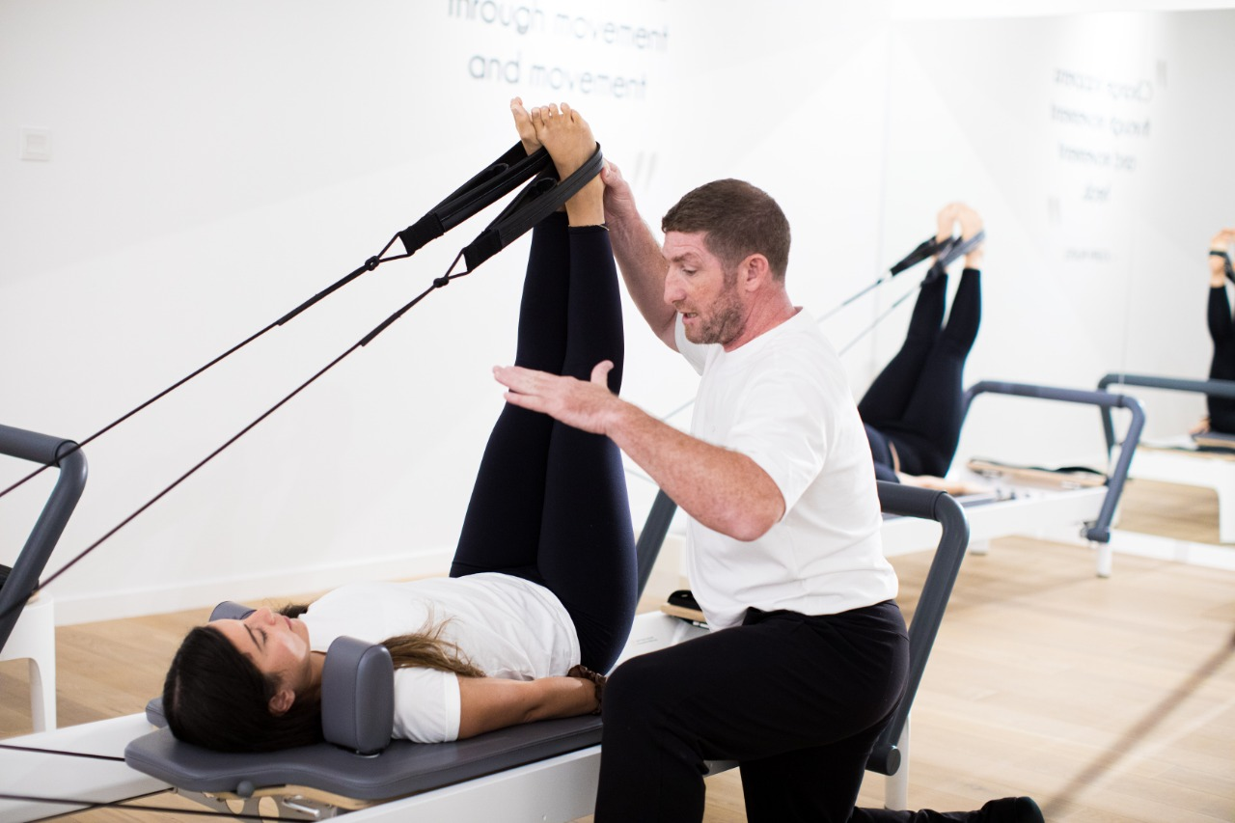
Why & When We Make Contact.
Introduction to each other
Postural Analysis
Helpful Cuing
Corrective Influence
Reinforcing Confidence
Human Interaction

Slide 4
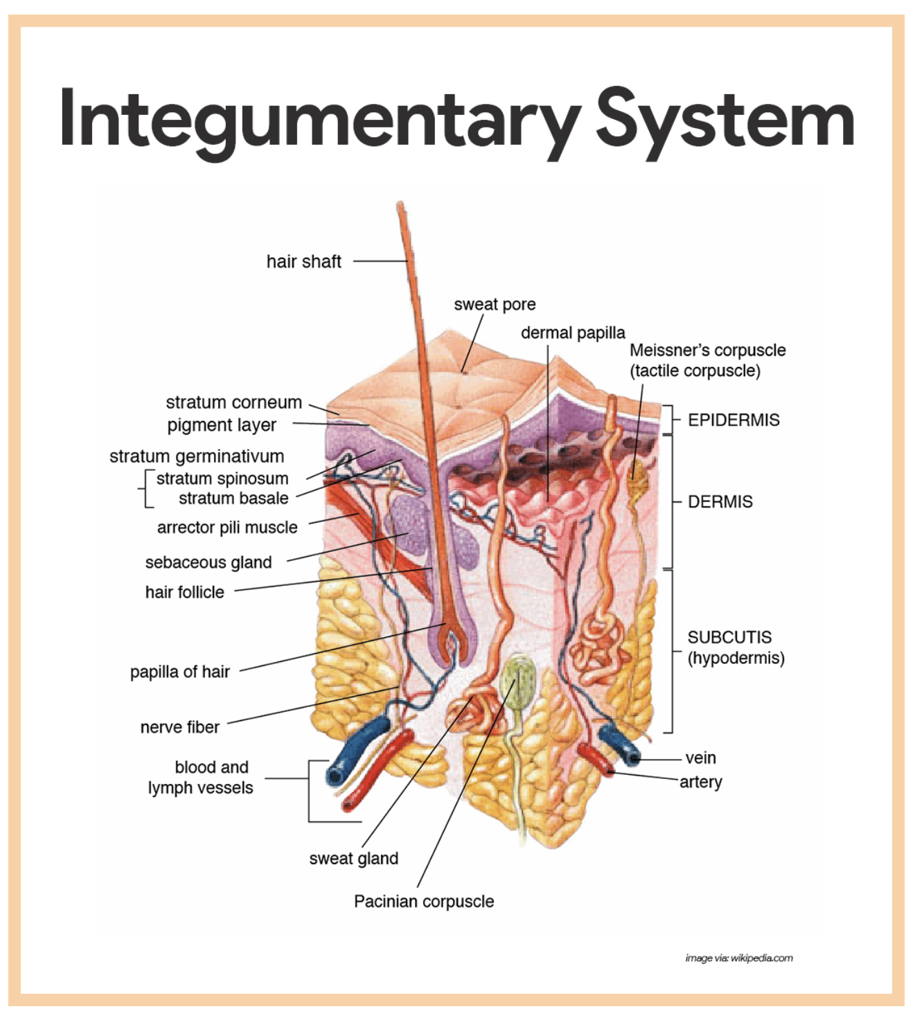
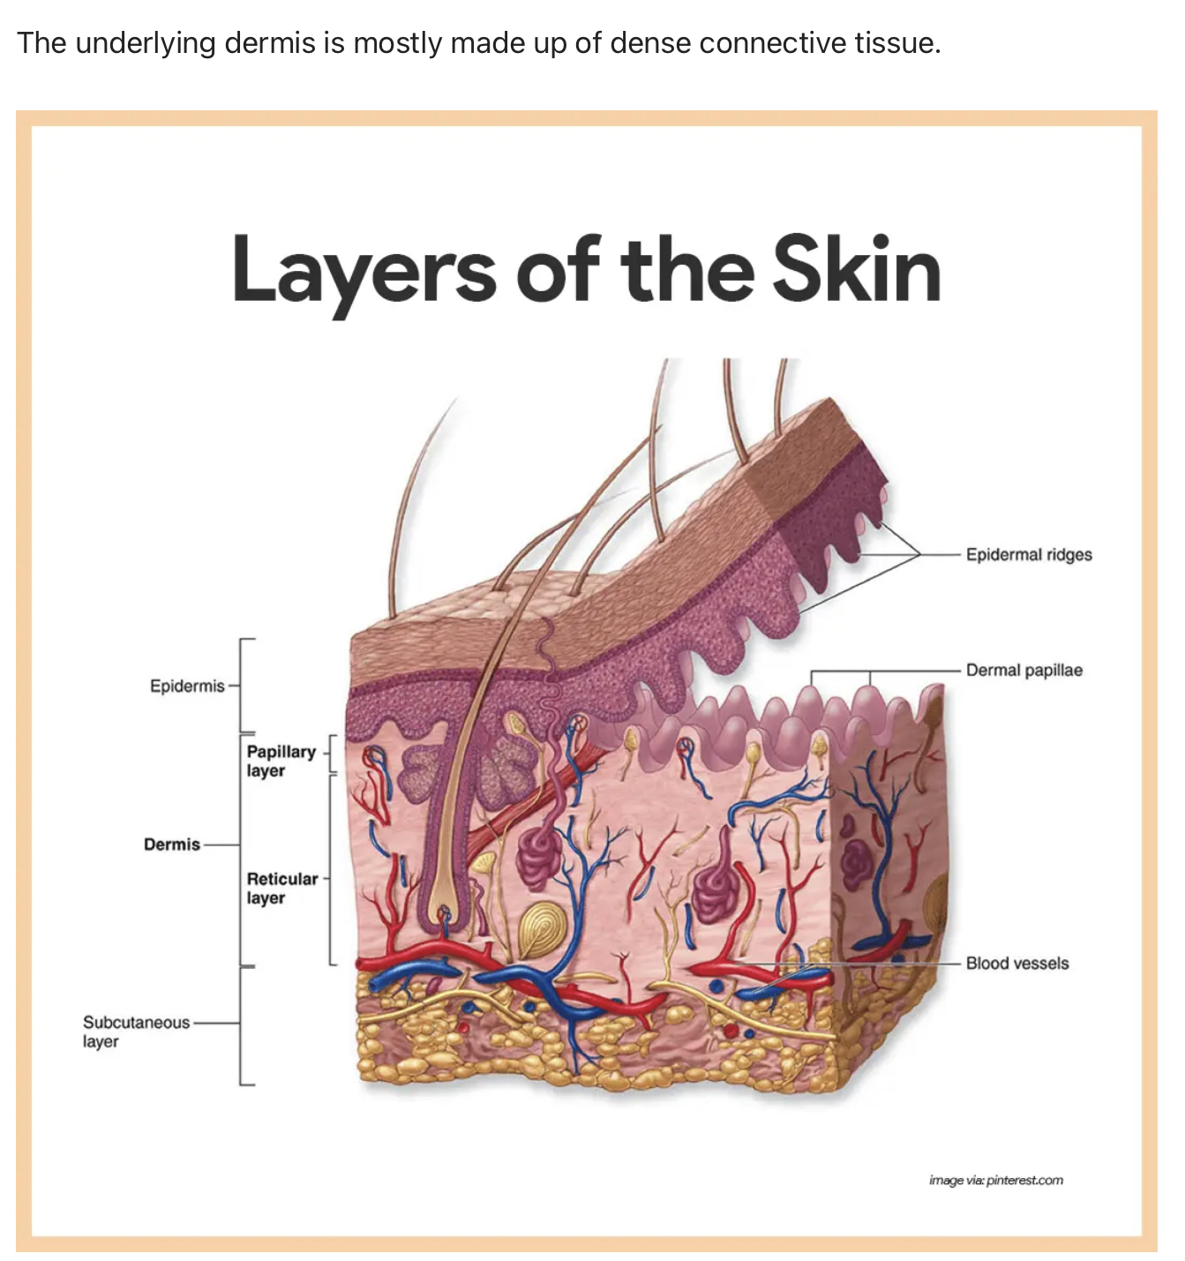
What Are You Touching?

Slide 5
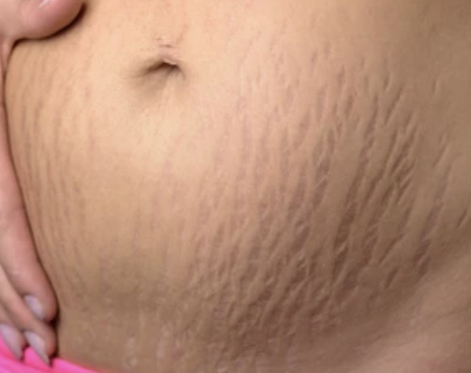
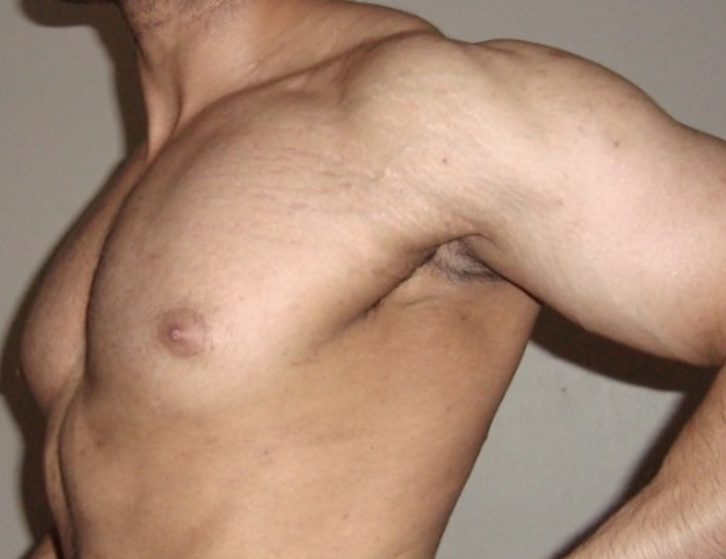
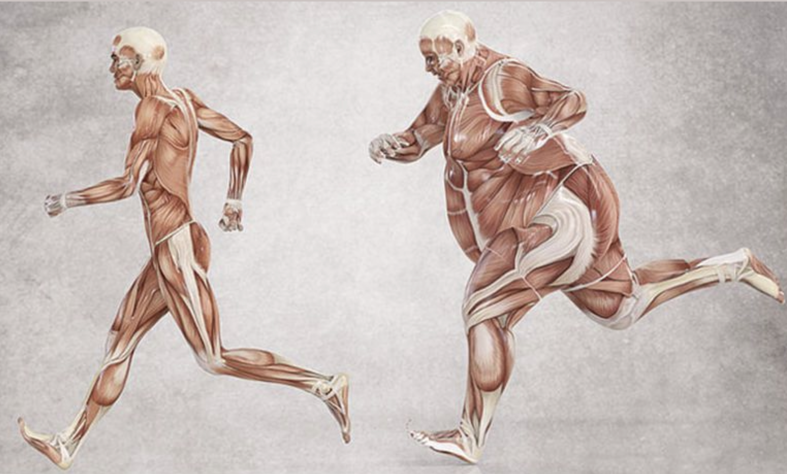
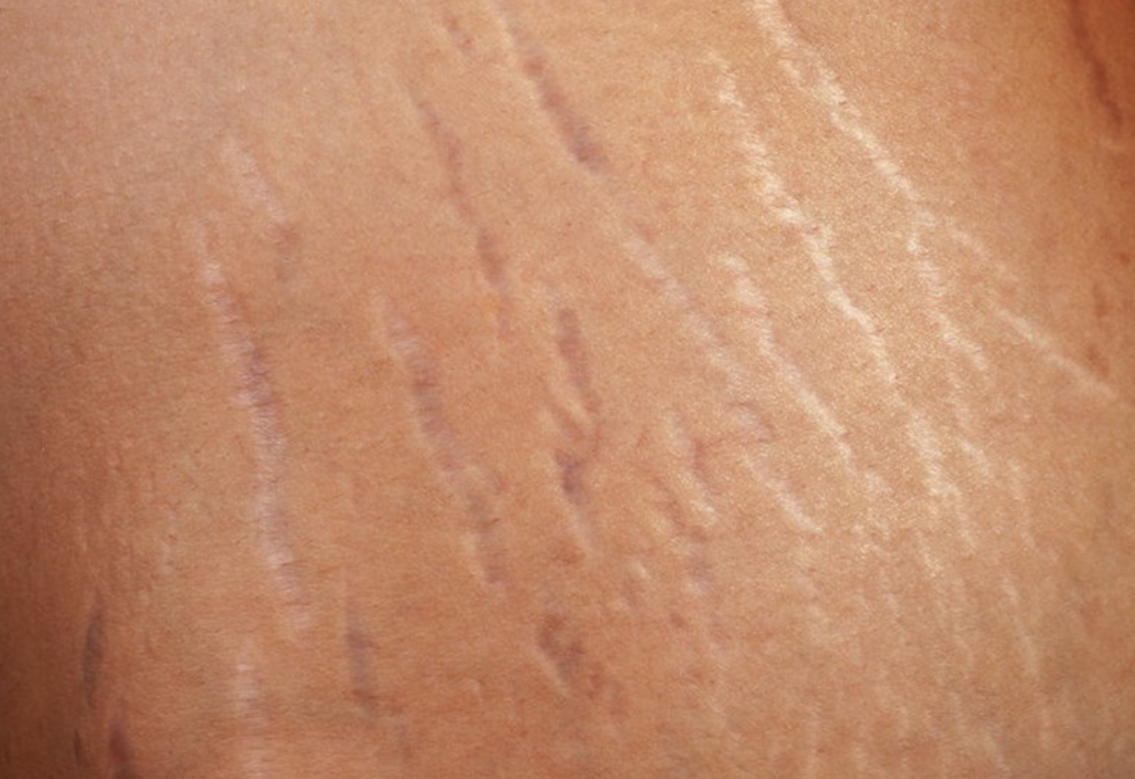
Integumentary System

Slide 6
Touch in Action

Slide 7
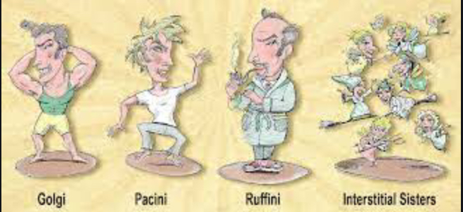
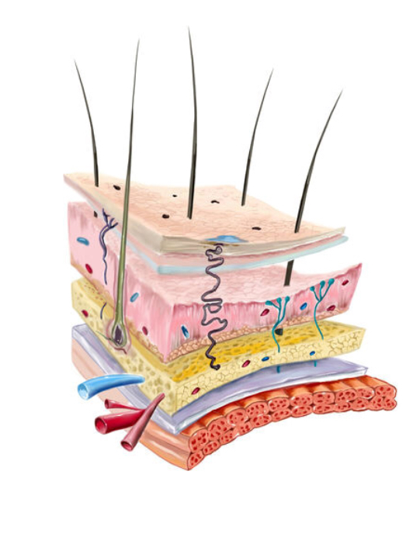
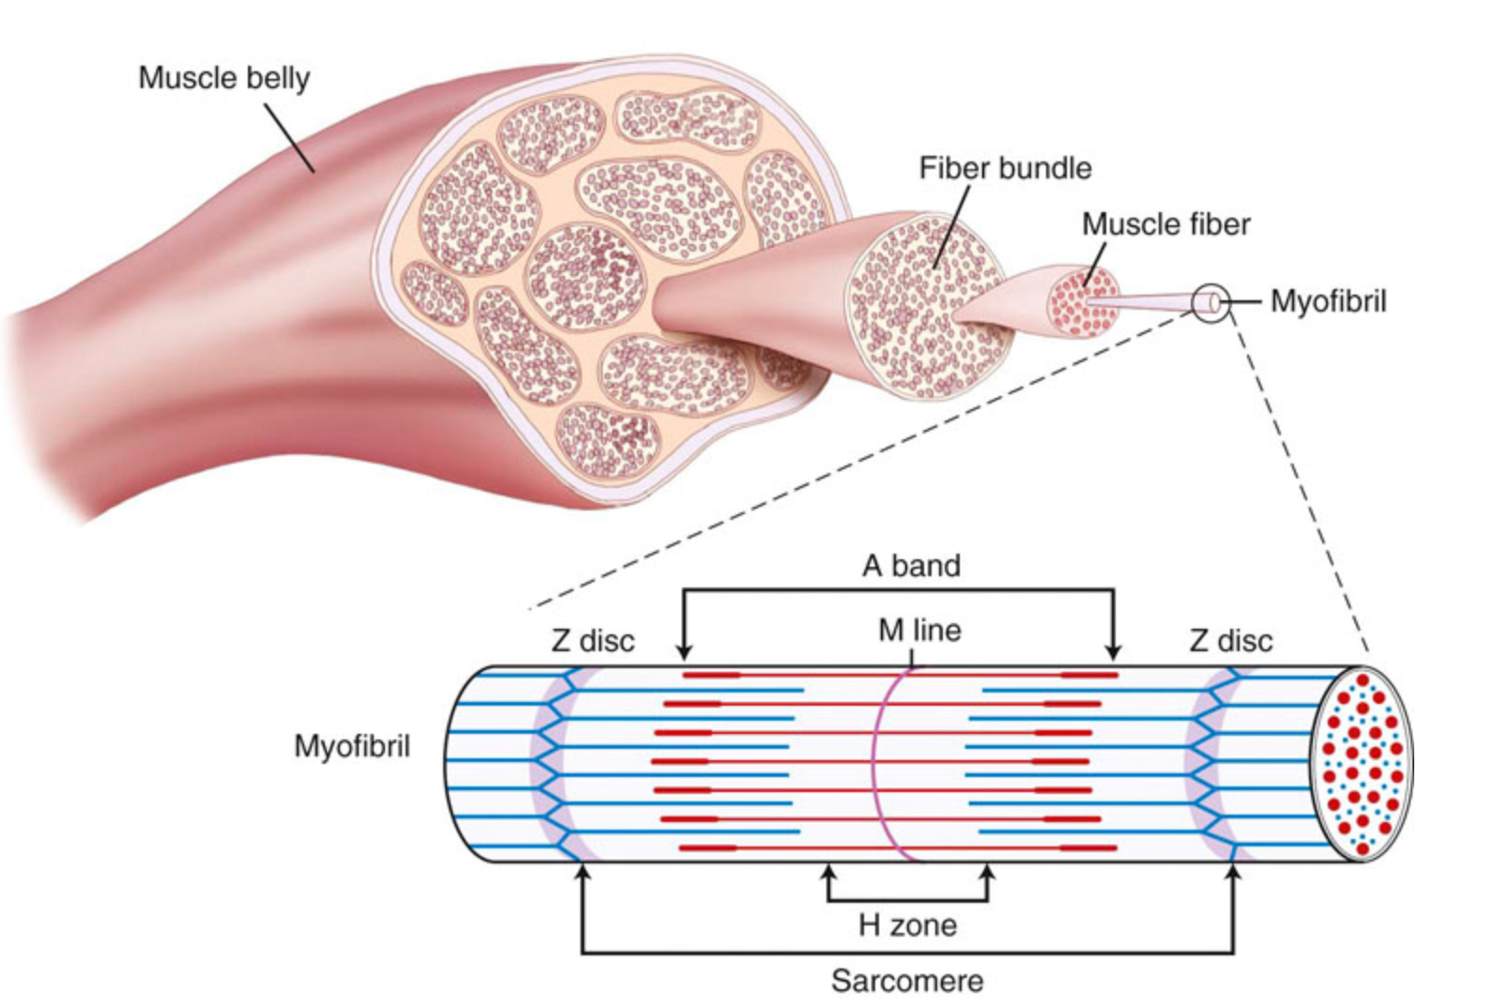
Neuro MyoFascia Skeletal System
Robert Shlieps Italian Neuro Family!

Slide 8
How Much is Enough?
Thermal Palpation
Light Touch Has A Dramatic Effect
Touch Confidently
Know Exactly Why & Where Your Touching
Receive & Share Sensory Information
Less Is More When Cuing

Slide 9
We Love Making Contact With Our Clients….. Should We Touch So Often?
Humans Love Contact
Do We Rely On This Too Regularly
Are We Touching For Our Benefit Or Theirs
Does Cuing This Way Become Instinctive
Instructors & Clients Becoming To Close
Is Palpation As Effective In Memory Retention?

Slide 10
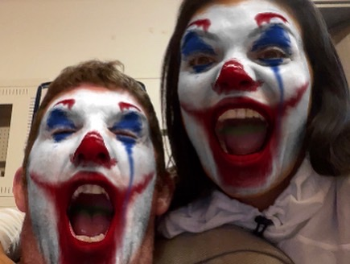
Experience Of The Client
Happy As It Was Helpful
Grateful
Confused
Frustrated
Surprised
Angry or Shocked
Inappropriately Made Uncomfortable

Slide 11
It’s A Privilege & Skill !
Respect The Skill You Have
Practice Daily To Become Proficient
Have Absolute Clarity As To Why Your Actually Making Contact
Only Touch What Your Specifically Talking About
Less Is Most Definitely More
Your Confidence & Competency Is Exuded From Your Interactions And Skilful Application Of Palpation

Slide 12
Creating Extraordinary Instructors
Thanks a Million

